Slide 1
The PGES Field Test
Lessons learned and Connections among PGES Framework, CHETL, MDC, and LDC

Slide 2
Presenters:
Bernadette Carpenter - Magoffin County Instructional Supervisor And Integration Grant Facilitator
Chris Meadows – Magoffin County High School Assistant Principal
Jennifer Howard – Math Teacher at Magoffin County High School, PGES Field Test Participant, and MDC Teacher Leader
Deidra Carpenter – Language Arts Teacher at Herald Whitaker Middle School and LDC Teacher Leader

Slide 3
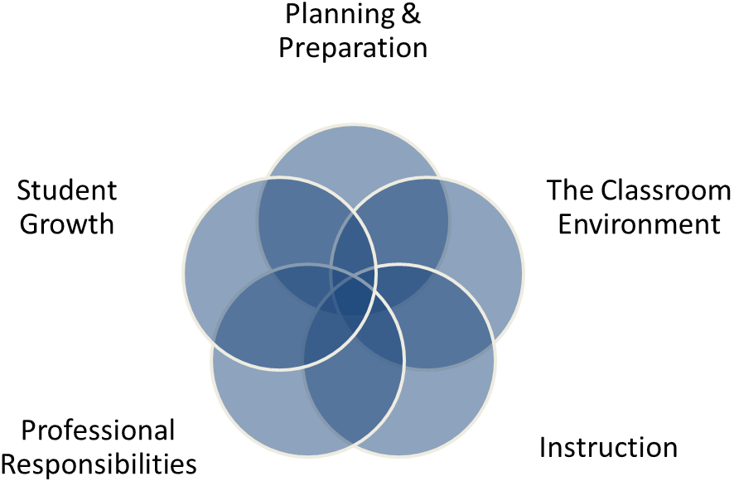
Framework Overview
Entire framework document can be found on the KDE website: PGES Link
Based on the work of Charlotte Danielson
Notes:
5 domains , 2 and 3 were looked at during observations

Slide 5
Logistics and Operations of PGES in Magoffin County School District
Teacher Selection for Pilot
Peer Observer Selection
Initial PGES Training Process with KDE
Monthly Principal PLC Meetings with Effectiveness Coach
Monthly district wide PLC meetings with LDC and MDC teacher leaders
Teacher Leaders attended Regional Cooperative Meetings
KDE Content Specialists trained groups of teachers
Notes:
Address Section 5 of Panel Questions, Who? How they were chosen? When did the planning for the pilot take place

Slide 6
PGES from the Teacher’s Perspective
Training
Reflective Practice and Professional Growth Planning
Student Growth Goal
Peer Observing
Pre and Post Conferencing
Influence of MDC
Influence of LDC
Notes:
Reflection time; Tool for assessment influence SMART GOAL;

Slide 7
PGES from the Administrator’s Perspective
Training and Certification
Reflective Practice and Professional Growth Planning
Student Growth Goal Setting
Observing
Pre-Conferencing and Post-Conferencing
School-wide Implementation
Notes:
Chris

Slide 8
PGES from the District Office Perspective
Strong Leadership is Key
District meeting for SMART Goal review is essential
Assist with tools for measuring student growth
Monitor timelines
Be aware of Student Voice Survey Issues
Notes:
Bernadette

Slide 9
PGES Domain 1- Planning and Preparation
A - Demonstrating Knowledge of Content and Pedagogy
LDC – Focuses on new standards and is a catalyst in covering those standards, particularly the Anchor Standards that now have to be addressed in content classes outside of ELA classrooms.
CHETL Section Five –Knowledge of the Content: All Teacher Characteristics
B -Demonstrating Knowledge of Students
LDC-Implements individual Lexile Levels so students are immersed with rigorous, engaging text that challenges students to move to the next level.
CHETL Section Two- Classroom Assessment and Reflection A: Teacher uses multiple methods to systematically gather data about student understanding and ability.
C - Selecting Instructional Outcomes
LDC - What Standards? What Skills? Pre assessment? Mode Of Writing? Does the student select the form?
CHETL Section Four- Instructional Relevance-All teacher and Student Characteristics

Slide 10
PGES Domain 1- Planning and Preparation
D - Demonstrating Knowledge of Resources
LDC-Module Creator, R-Group Space (One Stop Shop)
CHETL Section Four- Instructional Relevance F: Teacher integrates a variety of instructional resources to increase learning options.
E – Designing Coherent Instruction
LDC-Lots of group work and peer conversations after reading, writing, speaking, and listening. LDC modules just automatically lend themselves to appropriate structure through the use of the LDC Task and Module Creator.
CHETL Section One- All Teacher Characteristics in the Learning Climate Section
F – Designing Student Assessment
LDC – Use Of LDC Rubric as well as instructional rubrics, either teacher-made, or student-made throughout the mini tasks
CHETL Section Two- All teacher characteristics in the Classroom Assessment and Reflection Area

Slide 11
PGES Domain 2- Classroom Environment
A - Creating and Environment of Respect and Rapport
LDC-Teacher uses knowledge of student reading levels and uses whole-group instruction, small group instruction, and one-on-one instruction to increase mastery of standards.
CHETL Section One - all Teacher Characteristics in the Learning Climate Section.
B – Establishing a Culture for Learning
LDC-All students complete the writing product. No one just “floats through”. Teachers hold all students to high standards though a more individualized lesson in which students are exposed to challenging, but engaging text.
CHETL Section One- all Teacher Characteristics and Student Characteristics in the Learning Climate section – Pride in student work!
C – Managing Classroom Procedures
LDC-Lots of good discussions with colleagues during trainings through the “Give One/Get One” method concerning classroom management during Content Leadership Meetings and LDC Meetings. Use of classroom videos of quality instruction was paramount in the success of module implementation.
CHETL Section One- all Teacher Characteristics and Student Characteristics in the Learning Climate Section.

Slide 12
PGES Domain 2- Classroom Environment
D – Managing Student Behavior
LDC-Also gained lots of tips and tricks for behavior management during Content Leadership Meetings and LDC Meetings Videos of quality instructional practices were very helpful.
CHETL Section One- all Teacher Characteristics in the Learning Climate Section
E - Organizing Physical Space
LDC-Groups should be established and based on what is best for the student and the learning taking place.
CHETL Section One- all Teacher Characteristics in the Learning Climate Section

Slide 13
PGES Domain 3-Instruction
A – Communicating with Students
LDC – Preparing for Reading Section
CHETL Section 1: Learning Climate D-Teacher sets expectations or all students to attain individual literacy goals
B - Using Questioning and Discussion Techniques
LDC- Discussions and questioning techniques that require higher order thinking skills (training on questioning techniques to be done during PLCs this year).
CHETL Section Three: Instructional Rigor and Student Engagement C-Teacher Orchestrates effective classroom discussions, questioning, and learning tasks that promote higher-order thinking skills.
C - Engaging Students in Learning
LDC- Module Creator has Standards, Skills, Instructional Ladder, and Pacing Guide built in. LDC calls for coverage of content through engaging, but challenging activities.
CHETL Section Three: Instructional Rigor and Student Engagement F-Teacher Integrates a variety of resources with classroom instruction to increase learning options
Notes:
Preparing for Reading Steps

Slide 14
PGES Domain 3-Instruction
D - Using Assessment in Instruction
LDC Pre-assessment to attain reading levels and writing product as post-assessment
CHETL Section Two: Classroom Assessment and Reflection- All Teacher Characteristics and Student Characteristics
E - Demonstrating Flexibility and Responsiveness
LDC- Reflection Section
CHETL Section Two: J- Teacher Reflects on instruction and makes adjustments as student learning occurs.

Slide 15
PGES Domain 4- Professional Responsibilities
A - Reflecting on Teaching
LDC- Reflection on success and revision of modules
CHETL Section Two- Classroom Assessment and Reflection C: Teacher revises instructional strategies based upon student achievement data.
B – Maintaining Accurate Records
LDC-Formative assessment and mastery of skills
CHETL Section Two- Classroom Assessment and Reflection B: Teacher uses student work/data, observations of instruction, assignments and interactions with colleagues to reflect on and improve teaching practice
C – Communicating with Families
LDC
CHETL

Slide 16
PGES Domain 4- Professional Responsibilities
D – Participating in a Professional Community
LDC- Content level, school level, and district level PLCs
CHETL Section Five- Knowledge of Content B: Teacher maintains on-going awareness of current content developments
E – Growing and Developing Professionally
LDC- Feedback through the jurying process for modules
CHETL Section Five- Knowledge of Content B: : Teacher maintains on-going awareness of current content developments
F – Demonstrating Professionalism
LDC-District Writing Plan development that includes LDC implementation across all contents throughout the district
CHETL Section Five- Knowledge of Content B: : Teacher maintains on-going awareness of current content developments

Slide 17
Questions?

Slide 18
Contact Information
Bernadette.carpenter@magoffin.kyschools.us
Chris.meadows@magoffin.kyschools.us
Jennifer.howard@magoffin.kyschools.us
Diedra.carpenter@magoffin.kyschools.us

