Slide 1

Content Cadres: A Collaborative Structure for Cohesive Implementation of New Standards
Every Student, Every Classroom, Every Day: College/Career & Citizenship Ready!

Slide 2
Learning Targets
I can describe the structure of Content Cadres in Lincoln County.
I can describe how these collaborative structures were developed, how teacher leaders were selected, and the process used to implement the new ELA and Math standards.

Slide 3
Communication is Key!!!

Slide 4
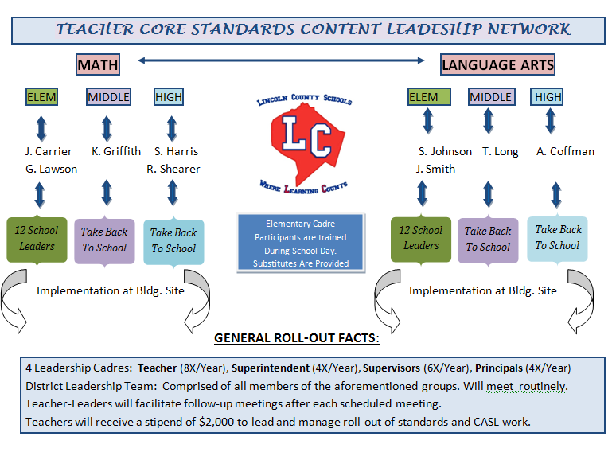
Notes:
Pam

Slide 5

The Right People in the Right Seats on the Bus!!
Think, Write, Pair, Share
Think – Jot down 3 characteristics you think would be needed by a Cadre Teacher Leader
Share your list with an elbow partner

Slide 6

Job Description

Slide 7
Provide Guidance and Direction

Slide 8
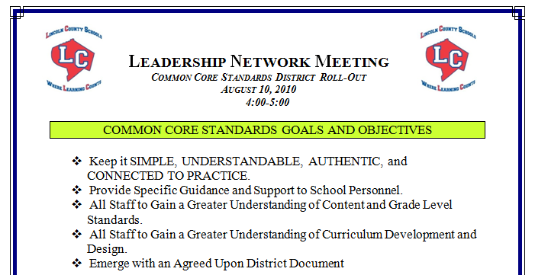
District Meeting Agenda

Slide 9
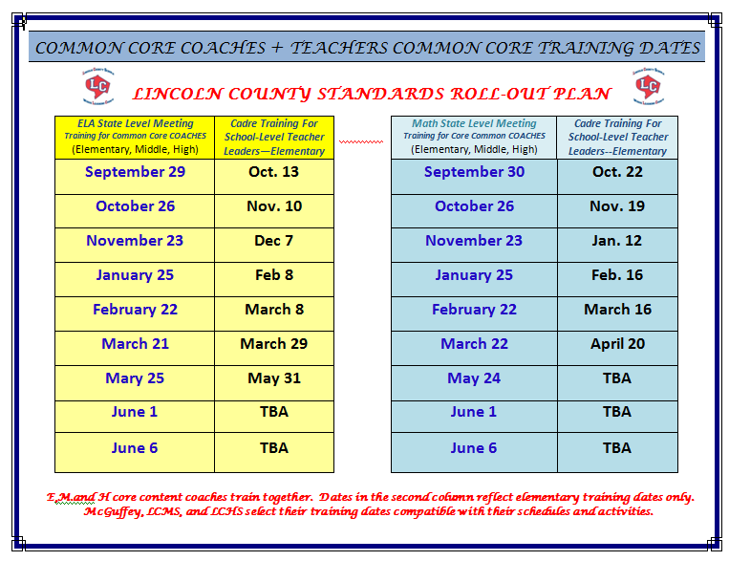

Slide 10
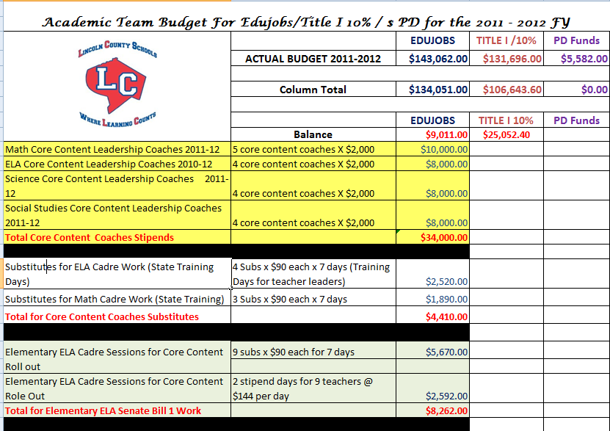
Resources and Support

Slide 11
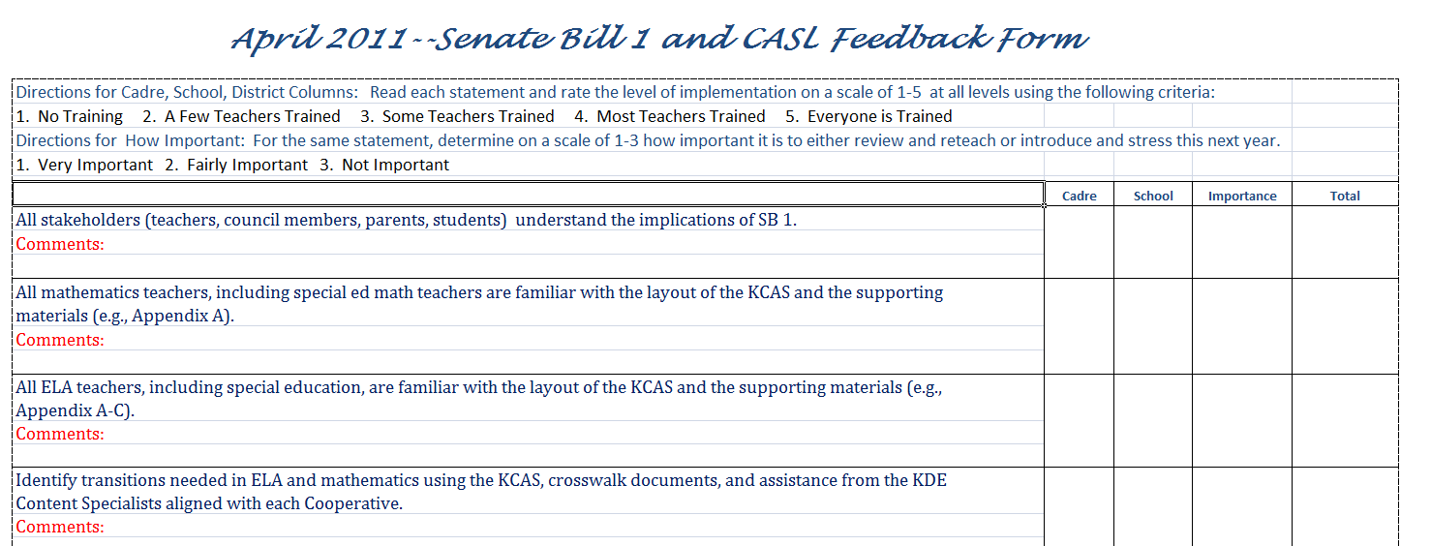
Collect and Respond to Feedback

Slide 12
Expanded to Include ALL Content Areas
Teacher Leaders at Elementary, MS & HS
Administrative support person for every content at every level
APC structure for sustainability

Slide 13
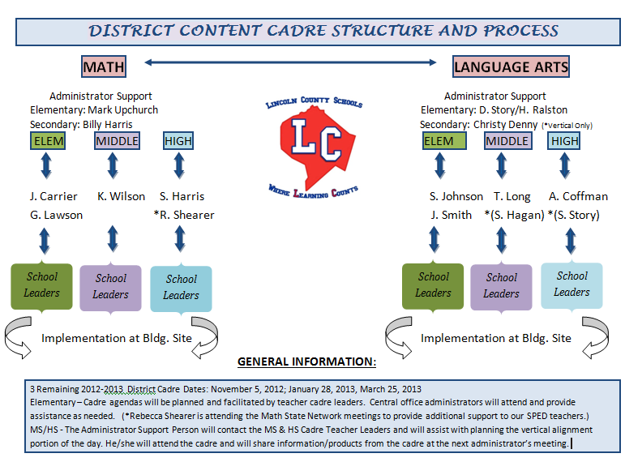

Slide 14
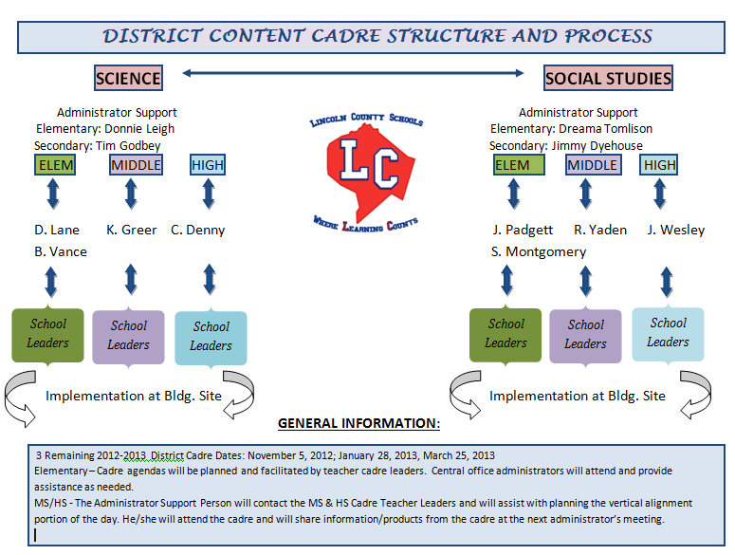

Slide 15
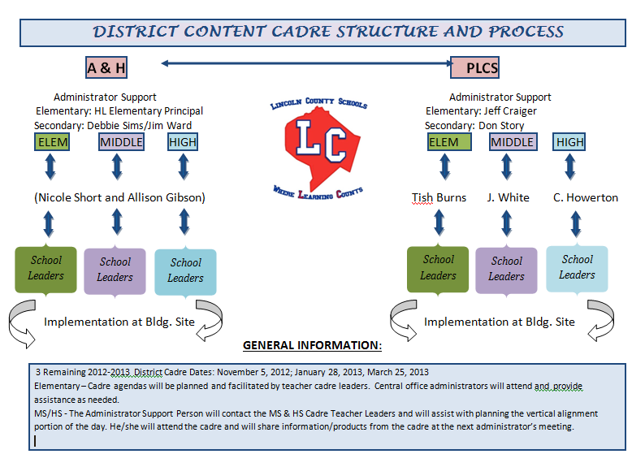

Slide 16
Turn and Talk
Notes:
What structures do you have in place in your own district that help you communicate systematically and intentionally?

Slide 17
The Work of the Cadre
Deconstructing the Standards
Outlined the Curriculum & Units
Developed Common Assessments
Incorporated CHETL
Incorporated Formative Assessments (CASL)
Used LDC to do research projects for Content Area Literacy Class

Slide 18
What Have We Learned?
The power of learning targets in dissecting our curriculum and creating assessments
Delve deeper into problematic standards so we can educate our teachers
Deeper understanding of the new Teacher Evaluation and CHETL

Slide 19
How has the Cadre impacted your classroom, school and district?
CLASSROOM LEVEL
A better understanding of the mathematical and ELA underpinnings of the standards
We are moving toward tying grading to standards/learning targets and homework has been taken out as summative grades
Formative assessments help to group students for differentiated instruction

Slide 20
How has the Cadre impacted your classroom, school and district?
SCHOOL LEVEL
Literacy was incorporated across all content areas
All teachers are using learning targets to align their instructional activities and assessments
Teachers participate in weekly PLCs to discuss curriculum, assessment and instruction and the impact on student learning

Slide 21
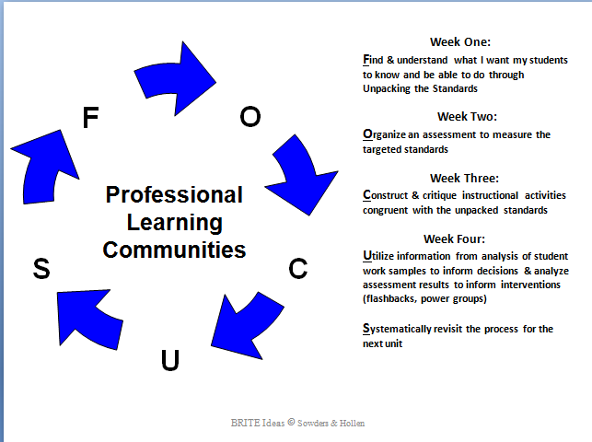
PLC Protocol

Slide 22
How has the Cadre impacted your classroom, school and district?
DISTRICT LEVEL
Vertical conversations about our mission statement
Vertical alignment of curriculum and assessment
Vertical conversations about how we can increase KPREP/EPAS scores
Scheduled meetings for teachers to talk across grade bands and schools

Slide 23
What are the Successes, Hurdles, and Challenges?
SUCCESSES
Actual conversations with teachers from K-5 and 6-12
Meeting students at his or her “Point of Need” - Creating plans to accelerate students who are academically gifted and meet the needs of struggling students
Vertical alignment in curriculum

Slide 24
What are the Successes, Hurdles, and Challenges?
HURDLES
At MS/HS level - Merging three math/ELA departments into a working cadre could have been challenging
Getting all six elementary schools on the same page with common assessments, instructional units and materials

Slide 25
What are the Successes, Hurdles, and Challenges?
CHALLENGES
Budget Woes! How do we fund Cadre work with impending funding cuts and have money for instructional resources and technology
Due to the increased rigor of the standards, some teachers are struggling with fully understanding the Common Core standards
Incorporating meaningful use of CIITS

Slide 26
Turn and Talk
Notes:
What are your successes/hurdles/challenges??

Slide 27
Cadres Carry-on!!!
Every Student, Every Classroom, Every Day: College/Career & Citizenship Ready!

Slide 28
Questions or Comments
Contact Us
Pam Hart - pam.hart@lincoln.kyschools.us
Thea Long – thea.long@lincoln.kyschools.us
Angela Cain – angela.cain@lincoln.kyschools.us

