Slide 1
Keeping the Promise through Literacy Leadership
Kelly Clark, KDE Literacy Consultant
Teresa Rogers, KDE Literacy Consultant
Katrina Slone, KDE Content Specialist

Slide 2


Slide 3


Slide 4


Slide 5


Slide 6


Slide 7


Slide 8
Grade Band | Lexile Band | Passage
12-CCSS | 1185-1385 | 1730
Applying it to the known solutions describing the hydrodynamic regime in AdS/CFT, we derive the hydrodynamic stress tensor of asymptotically flat black branes to second order, which is constrained by the parent conformal symmetry.
Notes:
Katrina – Quickly read and summarize to neighbor (timer 3 minutes)

Slide 9



Did you enjoy reading this?
Applying it to the known solutions describing the hydrodynamic regime in AdS/CFT, we derive the hydrodynamic stress tensor of asymptotically flat black branes to second order, which is constrained by the parent conformal symmetry.
Notes:
Katrina - How did you feel when you read this? Maybe like this (faces flash up)? What tripped you up (ovals flash up)? So, knowing how it feels to confront unfamiliar and unwieldy text, how will you support your teachers to support their students as they encounter these alien beings?
Introduce Teresa,

Slide 10
What tripped you up?
Complex vocabulary
Applying it to the known solutions describing the hydrodynamic regime in AdS/CFT, we derive the hydrodynamic stress tensor of asymptotically flat black branes to second order, which is constrained by the parent conformal symmetry.
Lack of background knowledge/context for material
Sentence structure (information density)
Notes:
Katrina - How did you feel when you read this? Maybe like this (faces flash up)? What tripped you up (ovals flash up)? So, knowing how it feels to confront unfamiliar and unwieldy text, how will you support your teachers to support their students as they encounter these alien beings?
Introduce Teresa,

Slide 11
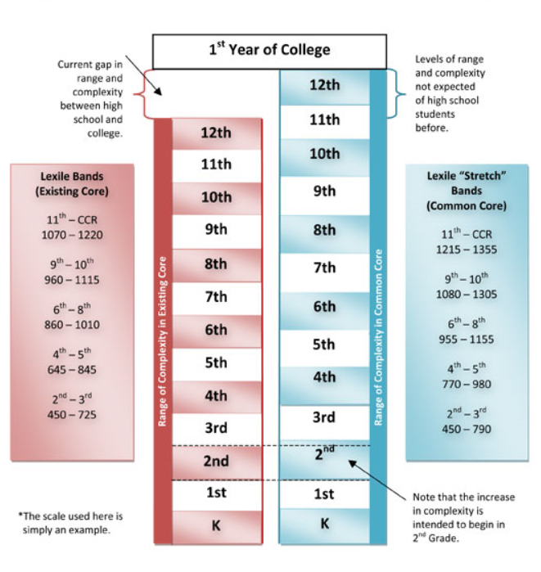
Previous gap in range and complexity between high school and college.
Notes:
Teresa – Demands of KCAS
The passage that we just read demonstrates the gap students face. Content area literacy:
Is dense in content knowledge
Includes complex technical terms
Requires integration of multiple concepts
Critical information is often presented in visuals

Slide 12
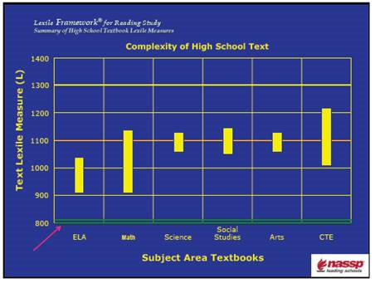
Notes:
Teresa
Where do we begin? First, literacy instruction must move beyond the ELA classroom.
To illustrate this point, let’s take a look at this comparison of the Lexile levels of high school textbooks. Notice the ELA textbook falls above 1000, but content area texts fall well above 1100.
So, where will students develop the skills needed to address these complex texts? Although English teachers can and do teacher general reading strategies, discipline specific strategies must be addressed by the experts, or in other words, content teachers. However, many teacher educator institutions fail to adequately prepare content area teachers in the use of appropriate literacy supports and strategies. This knowledge gap must be addresses through professional learning.
And now ask yourself, how prepared are your content teachers at recognizing and using the literacy skills necessary to access their content?
Do you, as the instructional supervisor know what research based literacy looks like? Sounds like in the classroom?

Slide 13


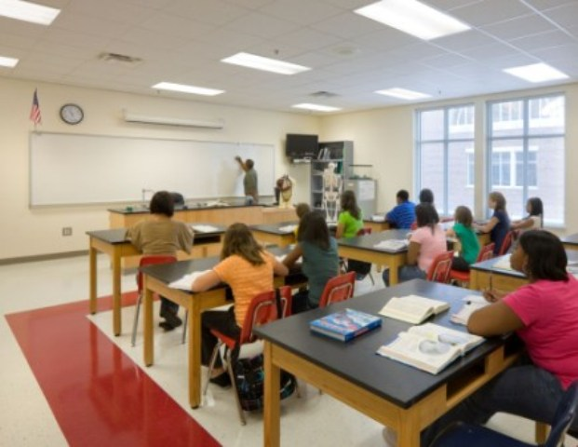
Read!
Write!
Notes:
Katrina: After teaching primary for several years and attending many PD sessions, I learned many strategies for teaching kindergarten and first grade children to read. I had that in the bag. Then I was moved to middle school to teach science and one class of reading. I had no idea how to teach reading to middle school kids. I thought they already knew how to read. I had one strategy—tell them to read! My writing strategy was similar. When the 7th grade language arts teacher demanded a writing piece for the portfolio, I gave it to her. She loved it—it never showed up in the portfolio and she stopped asking!

Slide 14
Misconception
They should know how to read by third grade.
If they can’t read, it’s not my job to teach them.

Slide 15


Slide 16
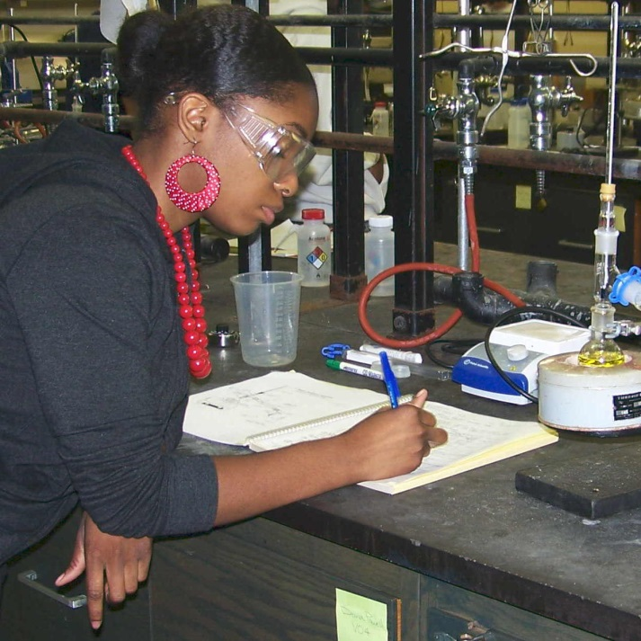
Notes:
Content area teachers are worried that they are being asked to become reading teachers. Many are concerned because they may have:
Little understanding of the reading process
Lack of instructional strategies to support the reading process and the diverse needs of students
However, we must be consistent in sharing the message that they are the reading experts in their content areas. They aren’t responsible for teaching basic reading skills, but they are the ones best suited to teaching content specific skills.

Slide 17
There’s no time to teach content and literacy.
Misconception
Notes:
Teresa

Slide 18

Notes:
Teresa
Research from "Reading in the Disciplines," by Carol Lee and Anika Spratley, sheds light on a vicious cycle, “If you don’t know content you will have a difficult time understanding the texts, and if you don’t understand the texts you are unlikely to learn content.”
In other words, compliance should not be an option.

Slide 19
Misconception
We can get all our teachers “on board” in one year.
Notes:
Kelly
Or put another way, lets get this literacy thing out of the way so we can focus on accountability, assessment, gap kids, the leaky roof, the angry parent – real problems.
TIME
Change takes time- introducing and supporting teachers in acquiring the skills to integrate literacy is a process, not a checklist.
Learning is recursive, develop experts and supports for your teachers – this is a collective effort, one that should be on a 3-5 year timeline. High expectations are not negotiable but allow for them to learn and practice before adding more.
Teachers are resistant to change, use your early adaptors to start but really push the teachers who show compliance but who will only take this on because they have to – there is a tipping point for change.
Be systematic, intentional and use data to chart your path
Support, encourage, push and shove – celebrate the victories
Let the teachers and students share their stories, powerful voices come from inside the classroom.
Let them know it will be hard, but you will be with them and support them with time, resources and clear goals.
By the way, increasing comprehension and literacy in the content areas will address the assessment issues, accountability and gap kids ( they can’t do well because they can’t understand- literacy is the key – give them the key) disclaimer: literacy may not fix the leaky roof-

Slide 20
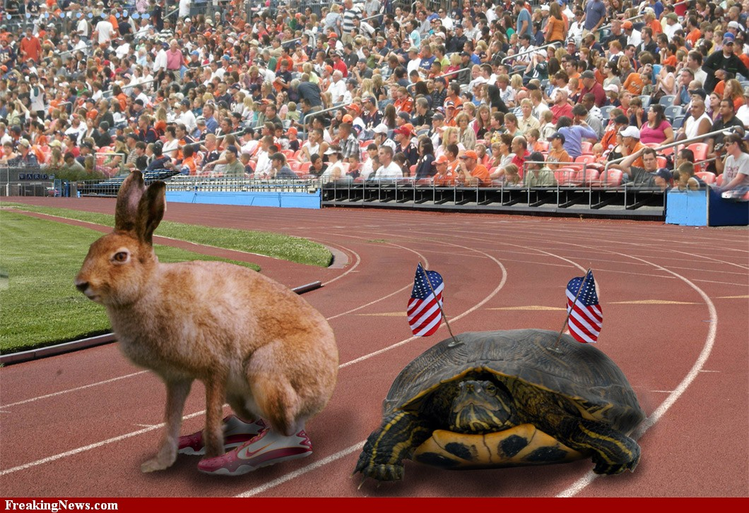

Slide 21
“Our kids can’t do that.”
“My teachers can’t do this.”
Misconception
Notes:
Katrina
My answer to this is, “You’re right!” They can’t unless you facilitate their learning how to do it.
As administrator, become familiar with what good literacy teaching looks like
Use the experts in your building, district, and cooperatives
Pair up ELA teachers with content teachers to co-teach, model lessons, and share strategies
Literacy Design Collaborative (LDC)
PD 360 videos
Foster self-efficacy in your teachers and demand they foster it in their students

Slide 22

Notes:
Teresa
As we close, how are you going to keep the promise to move students forward to be college and career ready by being literate in every content area?
How will you support your teachers in keeping this promise?
We will be in the open session AT??? TIME at table: ???? to answer your questions

