Slide 1


Speed bumps on the road to NGSS
Notes:
Revise title slide to add in MI STEM Partnership logo? Use these logos as the common slide template?

Slide 2
Old dullness can trump new standards

Slide 3
5-LS1-1. Support an argument that plants get the materials they need for growth chiefly from air and water. [Clarification Statement: Emphasis is on the idea that plant matter comes mostly from air and water, not from the soil.]
Read some stuff
Do some worksheets
Write an argumentative passage
Answer an ORQ
Take it on faith
Read some stuff
Grow some plants and measure soil mass before/after
Write an argumentative passage
Prove it to yourself

Slide 4
HS-PS2-6. Communicate scientific and technical information about why the molecular-level structure is important in the functioning of designed materials.
Read some stuff
Do some worksheets
Write report with data tables or diagrams
Answer an ORQ
Take it on faith
Read some stuff
Conduct investigations using compounds of varied structures…
Select an appropriate format…
Prove it to yourself

Slide 5
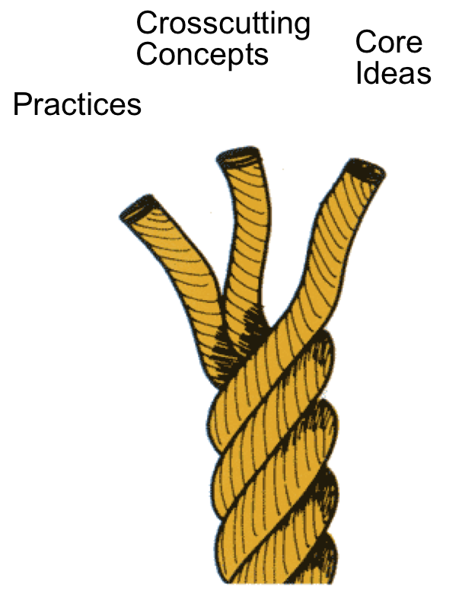
NGSS Architecture
Integration of practices, crosscutting concepts, and core ideas.
Notes:
Some of these notes are slightly repetitive from before, I cleaned up some of it, but have left the rest, feel free to edit.
. . . science and engineering education should focus on a limited number of disciplinary core ideas and crosscutting concepts, be designed so that students continually build on and revise their knowledge and abilities over multiple years, and support the integration of such knowledge and abilities with the practices needed to engage in scientific inquiry and engineering design (Framework, p. ES 1).
Thus it [the Framework] describes the major practices, crosscutting concepts, and disciplinary core ideas that all students should be familiar with by the end of high school, and it provides an outline of how these practices, concepts, and ideas should be developed across the grade levels (Framework, p. 1-1) .
By the end of the 12th grade, students should have gained sufficient knowledge of the practices, crosscutting concepts, and core ideas of science and engineering to engage in public discussions on science-related issues, to be critical consumers of scientific information related to their everyday lives, and to continue to learn about science throughout their lives. They should come to appreciate that science and the current scientific understanding of the world are the result of many hundreds of years of creative human endeavor. It is especially important to note that the above goals are for all students, not just those who pursue careers in science, engineering, or technology or those who continue on to higher education (Framework, p. 1-2).
Students actively engage in scientific and engineering practices in order to deepen their understanding of crosscutting concepts and disciplinary core ideas (Framework, p. 9-1).
In order to achieve the vision embodied in the framework and to best support students’ learning, all three dimensions need to be integrated into the system of standards, curriculum, instruction, and assessment (Framework, p. 9-1).
Furthermore, crosscutting concepts have value because they provide students with connections and intellectual tools that are related across the differing areas of disciplinary content and can enrich their application of practices and their understanding of core ideas (Framework, p. 9-1).
Thus standards and performance expectations must be designed to gather evidence of students’ ability to apply the practices and their understanding of the crosscutting concepts in the contexts of specific applications in multiple disciplinary areas (Framework, p. 9-1 & 2).
When standards are developed that are based on the framework, they will need to include performance expectations that cover all of the disciplinary core ideas, integrate practices, and link to crosscutting concepts when appropriate (Framework, p. 9-3).
In sum, teachers at all levels must understand the scientific and engineering practices crosscutting concepts, and disciplinary core ideas ; how students learn them; and the range of instructional strategies that can support their learning. Furthermore, teachers need to learn how to use student-developed models, classroom discourse, and other formative assessment approaches to gauge student thinking and design further instruction based on it (Framework, p. 10-10).

Slide 6
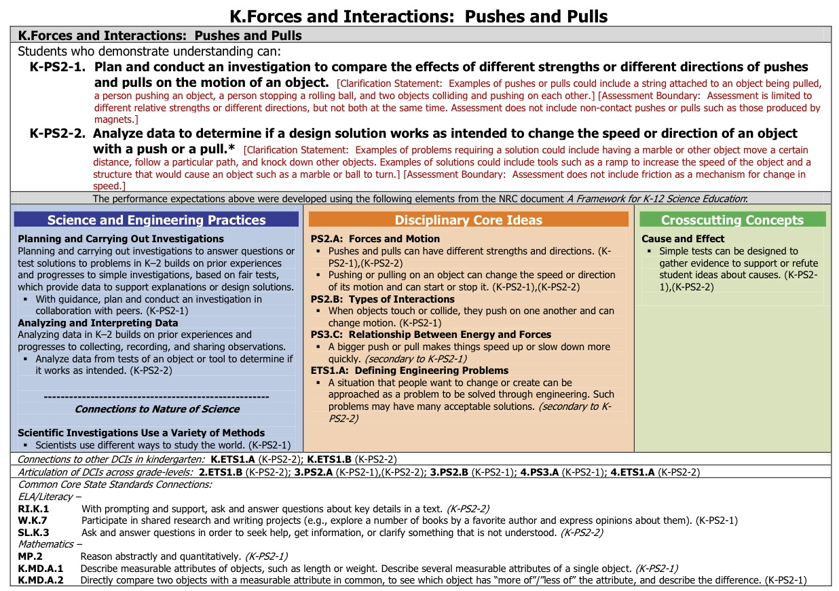

Slide 10
Crosswalk?

Slide 11



Avoid the folder swap

Slide 12
“The new standards don’t really impact me very much because I teach high school but I don’t teach biology”

Slide 13

The nebular theory of curriculum accretion in action

Slide 14
“We already do this”
P(tadt)=1/n(swdt)
Notes:
Probability (they actually do that)=1/#of times (they say we do that)

Slide 15
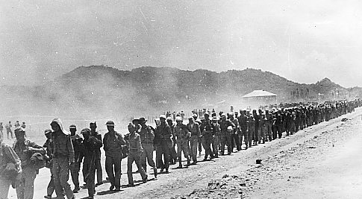
Death march through the bullets

Slide 16
http://youtu.be/GO6B1K1ciBI
Notes:
Think of what people know about NGSS and what really IS and what they’ll KNOW after they’ve been exposed to the standards.

