Slide 1
Focus! Focus! Focus! Bringing It All Together
Spencer County Public Schools

Slide 2
Getting to Know Us
Erin Tobbe, SCES Instructional Coach
Laura James, SCMS Language Arts Teacher
Kim Cook, SCHS English Teacher
Norma Thurman, Asst. Superintendent

Slide 3
Spencer County Schools - Taylorsville
2800 Students
2 Elementary Schools, 1 Middle School, 1 High School, 1 Alternative School
F/R Lunch – approximately 40%
2012 Proficient District

Slide 5
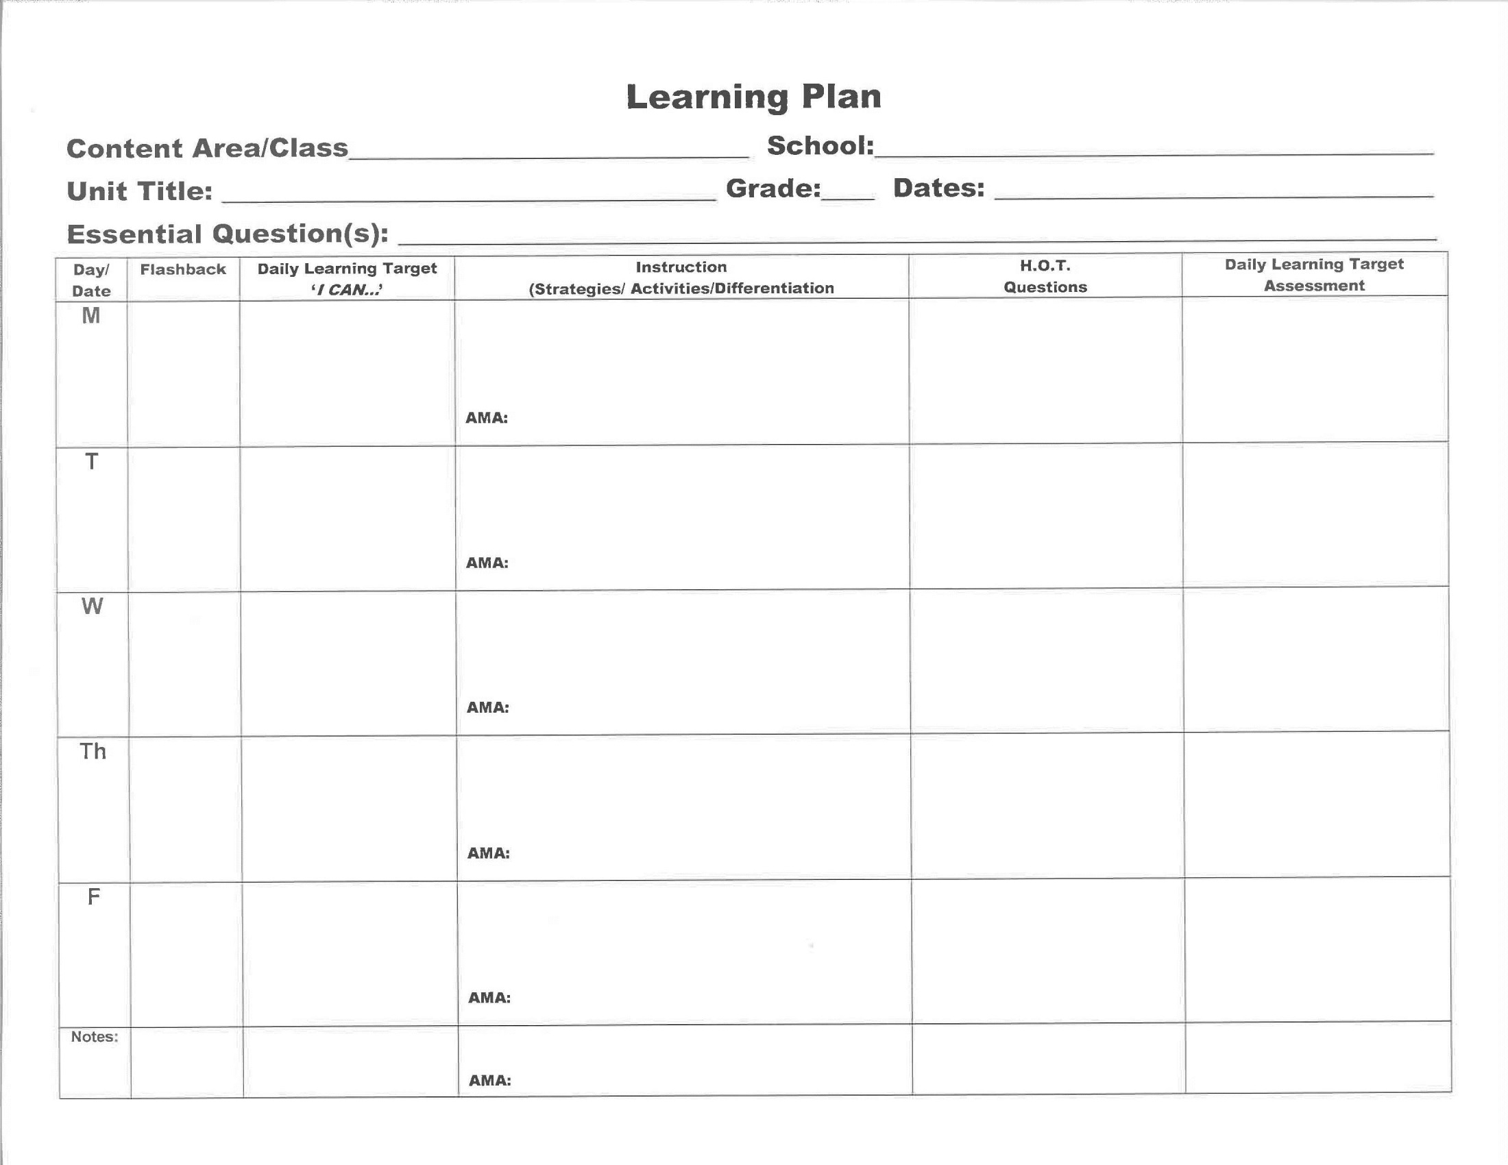

Slide 6
Essential Question
How can a systematic process for planning positively impact student learning?

Slide 7
Daily Learning Target
I can communicate the components and purpose of a learning plan.

Slide 8
Essential Questions

Slide 9
Essential Questions…
Are meant to be argued with a variety of plausible responses.
Require new thought.
Are designed to provoke and sustain student inquiry, while also focusing student’s learning.
Often address the conceptual or philosophical foundations of a discipline.
Raise other important questions.
Naturally and appropriately recur.

Slide 10
Essential Questions are NOT…
Confined to a “right” or “yes or no” answer.
Wanting recited facts.
Limited to one lesson or one day.
A BIG question that covers a lot of ground.
NON-EXAMPLES:
What is an inference?
List 10 carbohydrates.
Who was involved in and won the Civil War?
What is a habitat? What is a niche?
Can you graph a quadratic equation?

Slide 11
Essential Questions K-12
Primary
Questions about traits (What makes a good friend?)
Questions that invite them to speculate, predict, or imagine (What do you supposed would happen if we took away television?)
Questions that play on their natural curiosities (Why do you suppose the rain falls down?)
Intermediate
Questions listed above will work, but they are deeper or complex (What are the traits of a good leader?
Middle
Understanding characteristics or traits (How do we know if a law is just?)
Understanding why life turns out the way it does (Why do some friends stick by you while others are quick to flee at the first sign of trouble?)
Invention and problem solving (How can our nation best handle the influx of immigrants?)
High
Questions now move toward depth and complexity, demanding more originality, perception, and discovery (What is the price of progress?)

Slide 12
Applying EQs to Skill Areas
EQs in skill areas may be categorized into the following:
Key concept (What are the “big ideas”?)
Purpose, value (Why is the skill important?)
Strategy, tactics (What strategies do skilled performers employ?)
Context (When should you use the skill?
UNDERLYING CONCEPTS
How do you know that you comprehend what you are reading?
PURPOSE, VALUE
Why should readers regularly monitor their comprehension?
READING
STRATEGY
What do good readers do when they don’t understand a text?
CONTEXT
When should you use the various “fix-up” strategies?

Slide 13
Flashbacks: What it Looks Like
5 minutes at the beginning of class
Question(s) cover previously learned content
Multiple choice questions to mimic KPREP or ACT questions
Focus on different strands or RIT bands each day
Answered individually

Slide 14
Flashbacks: Example Page

Slide 15
Flashbacks: How it Works
For Students:
See patterns develop to help identify areas of weakness or needed focus.
Monitor progress over a period of time.
Acquire test taking skills and learn how to approach different types of questions through teacher modeling/think-aloud instruction.
For Teachers:
Tailor instruction based on student need.
Monitor progress over a period of time.
Protects time for daily test prep

Slide 16
Flashbacks: What it is NOT
Random
Requires front loading and intentional planning.
Can be common among grade levels.
Used in Isolation
Trends and patterns among students/classes should be used to inform instructional focus or to develop mini-lessons to accompany lessons/units

Slide 17
Flashbacks: Resources for Teachers
Many different types of resources are relevant for constructing quality Flashback questions. Teachers in our district have found the following resources to be helpful:
ACT Prep Questions
Quality Core Database
PLAN Sample Questions
COACH Materials (or other similar materials)

Slide 18
Instruction

Slide 19
Instruction (Strategies/Activities/Differentiation)
This portion of the learning plan describes what the teacher and students will be doing during a class period.
Resource materials may be listed and instruction should directly align with the Daily Learning Target and prepare the students for the Daily Learning Target Assessment.
This is where teachers may makes notes to add resources or instructional notes in order to make changes for the following year.
This portion of the learning plan needs to be viewed as a working document.
Some teachers may need more details while other may not. It is important to highlight examples and common core standards so that teaching and learning can be focused and intentional.

Slide 20
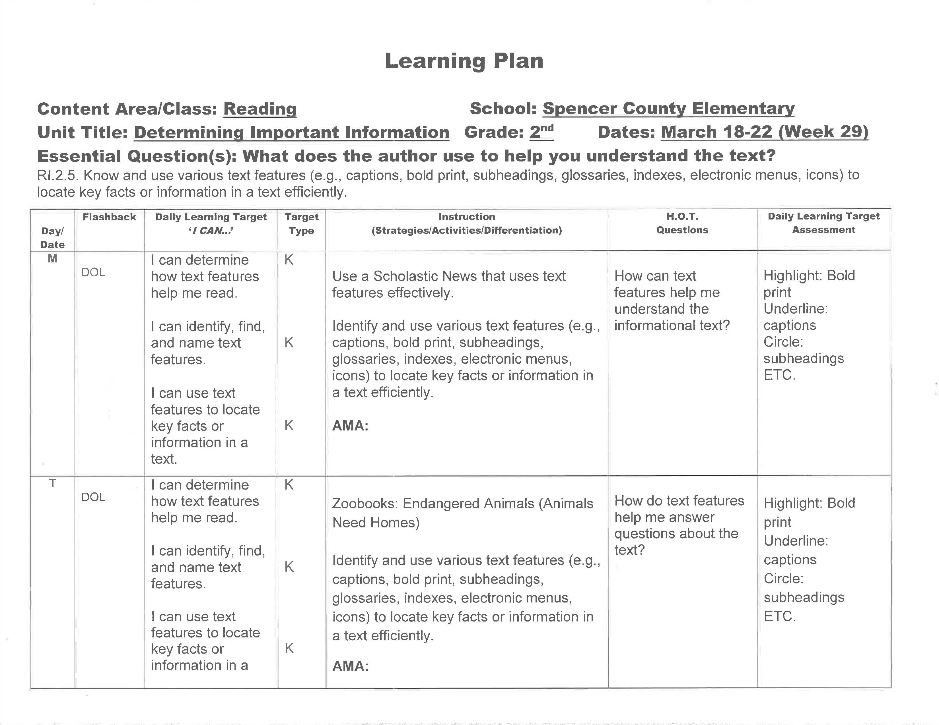

Slide 21
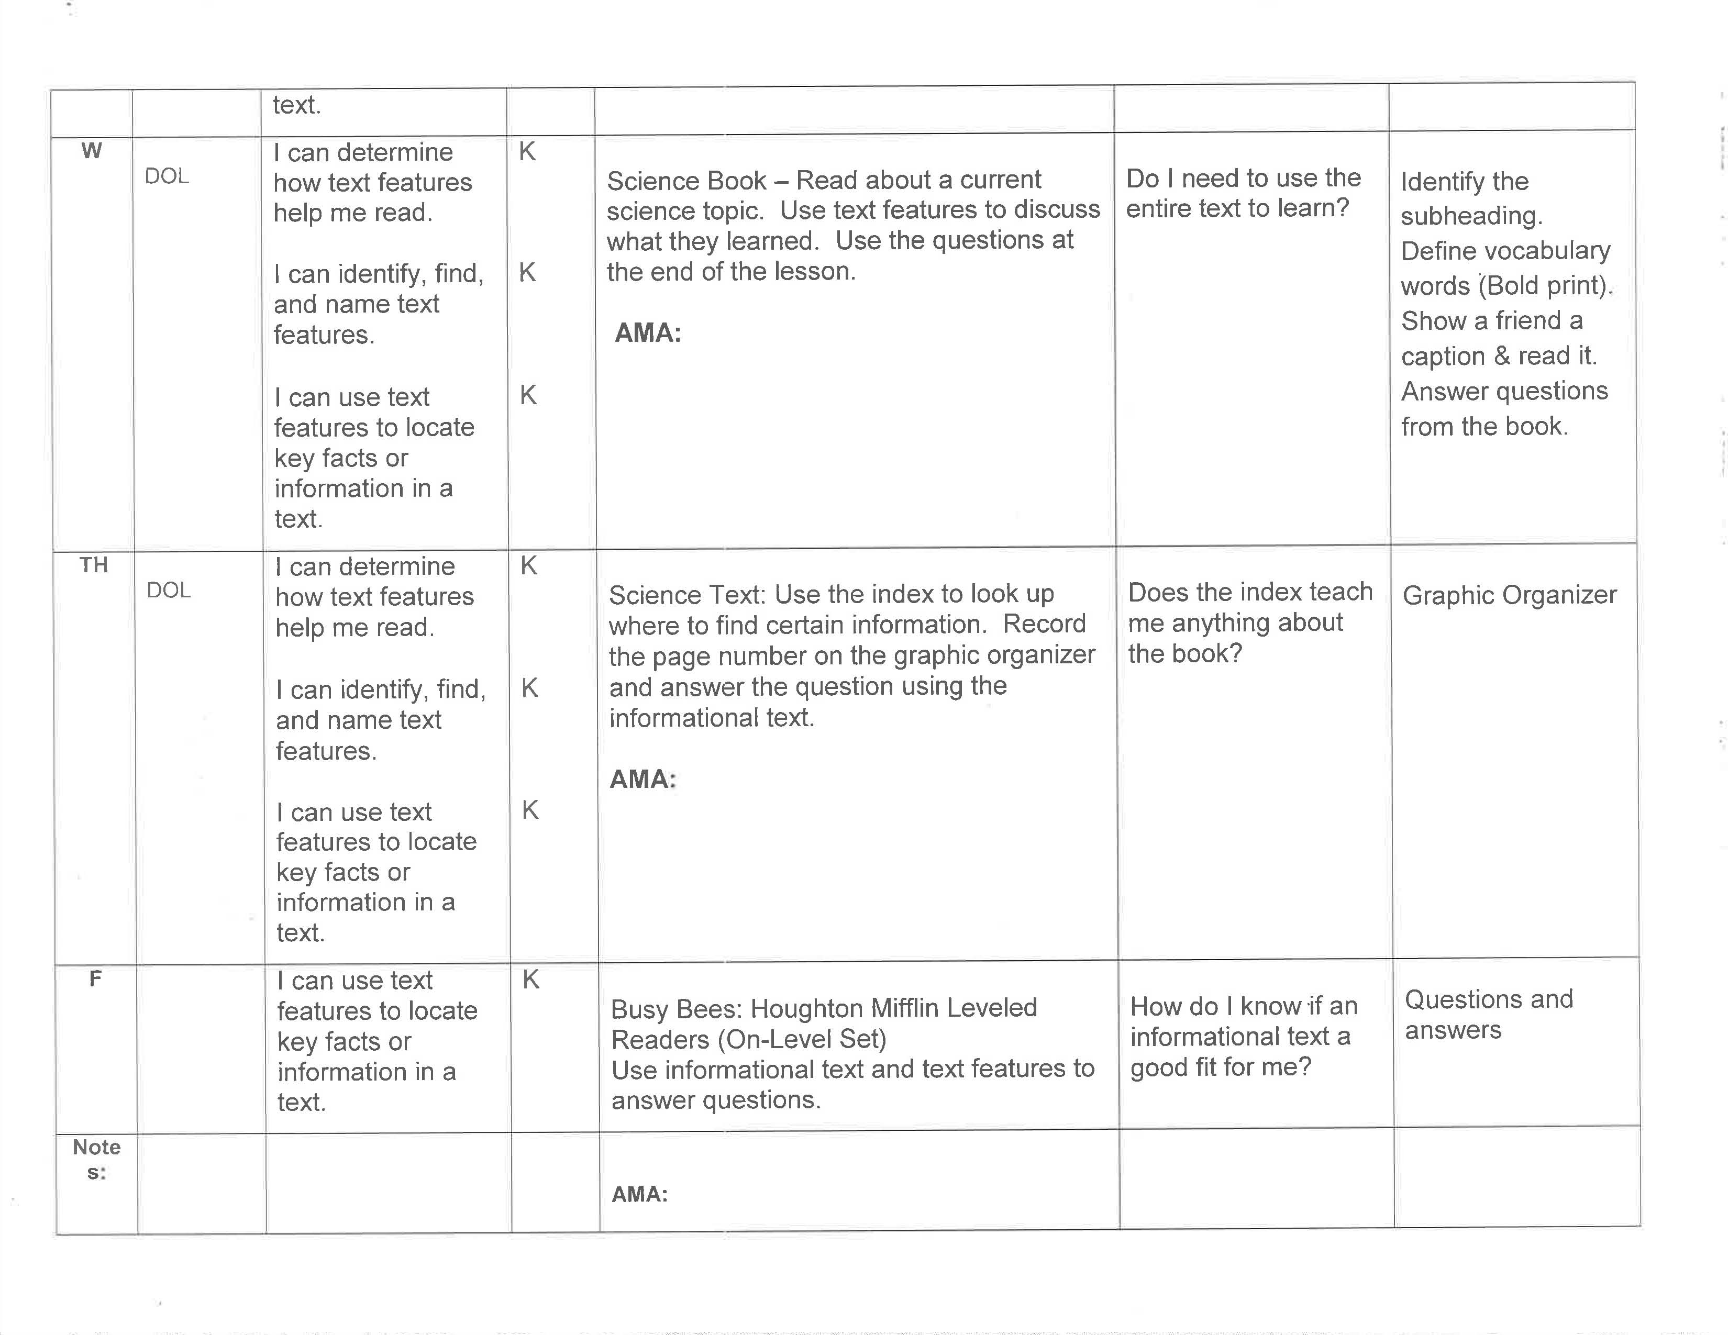

Slide 22
AMA Accommodations, Modifications, & Adaptations
Provides instructional variations for ECE population
Completed by or in conjunction with ECE teachers
Serves as a line of communication between ECE and general education teachers

Slide 23
HOT Questions
Higher Order Thinking
Questions

Slide 24
Why are HOT questions included on the District Learning Plan?
Spencer County Teachers are expected to include HOT questions in their daily learning plans so that they are an intentional part of the lesson.
The goal was to move from knowledge type questions to synthesizing, analyzing, and reasoning questions.
Going through the process of planning for HOT questions in each lesson with PLCs gave the teachers practice creating the questions, which increased comfort with asking HOT questions, including wait time, and including them more frequently during each lesson.

Slide 25
How has this evolved in the classroom?
After valuable discussion in PLCs, teachers have come up with creative ways to include HOT questions in their daily instruction.
Clipboard to have them out and accessible
Smart beads
HOT question stick
Many teachers now are encouraging students to create their own HOT questions to be used during class discussions.

Slide 26
HOT Questions are Based on Research
Our teachers use Marzano’s Questioning Stems when discussing and the intentional planning of HOT questions. “When used effectively, questioning can be one of the most flexible and adaptive tools in a teacher’s arsenal.” (Marzano, 2007)
It is also important to ask a variety of HOT questions over time according to Text Complexity Raising Rigor in Reading. (Fisher, Frey, Lapp 2012) They reference the 21st Century Version of Bloom’s Taxonomy and its importance in guiding students to read a variety of levels, from remembering to creating.

Slide 27
Bloom’s Taxonomy in the 21st Century
Creating
Evaluating
Analyzing
Applying
Understanding
Remembering

Slide 28
Daily Learning Target Assessment

Slide 29
What is a Daily Learning Target Assessment (DLTA)?
Very brief formative assessment that truly and quickly assesses the learning target for that particular day.
Should take 5 minutes or less for the students to complete, and it should be easy to grade.
IMPORTANT – Must be congruent to the standard and activity.

Slide 30
Why is the DLTA a required part of the Learning Template?
Spencer County teachers are expected to formatively assess students’ mastery of the learning target everyday.
To effectively implement standards based instruction, each standard must be assessed as it is taught, intentionally.
Each day this will be a formative assessment, meaning the data from these MUST be used to impact instructional decisions.

Slide 31
DLTAs are Based on Research
Rick Stiggins
CHETL

Slide 32
DLTA Strategies
Exit Slips
Self-Assessments (thumbs up/down, I Got It continuum, Traffic Lights)
Multiple Choice (Qualit6y Core/ACT practice/AP Practice/Compass Practice
Graphic Organizers

Slide 33
How do we monitor?

Slide 34
Spencer County Public Schools
Curriculum, Instruction & Assessment
website address:
http://publicschools.spencercounty.ky.gov/instruct.htm

