Slide 1

Engaging our Youngest Writers
Ruthie Staley and Nancy Huston

Slide 2
Teach Writing Like a Reader
Think aloud as we write
Think aloud as we read aloud
Notice what authors and illustrators do
Think and write with our students
Analyze effective writing of students and published authors
Compare and discuss good examples of writing and non-examples
Celebrate words and language
Notes:
Share your writing lives with your students…be explicit…

Slide 3
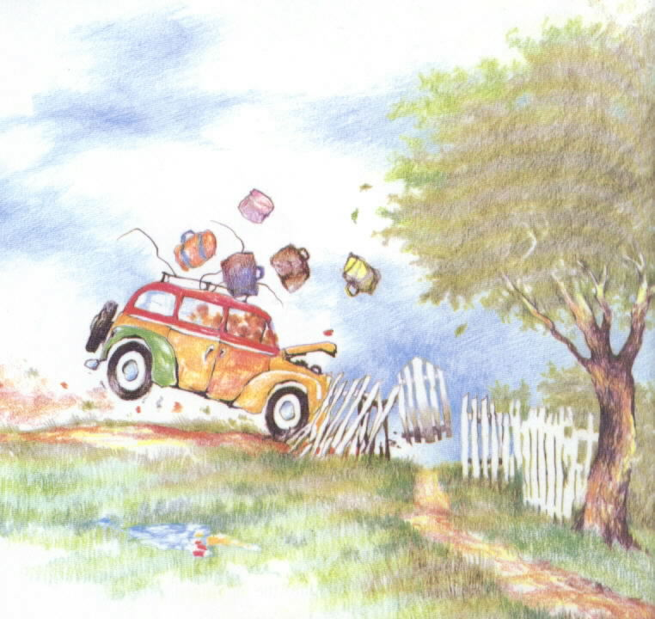
So they drank up all their pop and ate up all their crackers and traveled up
all those miles until finally they pulled into our yard.
Notes:
So they drank up all their pop and ate up all their crackers and traveled up all those miles until finally they pulled into our yard.

Slide 4
Teach Reading Like a Writer
Notice something about the craft of the text
Talk about it and make a theory about why a writer might use this craft.
Give the craft a name.
Think of other texts you know. Have you seen this craft before?
Try and envision using this crafting in your own writing.
Notes:
In order to understand what this means, we are going to experience the process.
Chapter 6 in Wondrous Words

Slide 5
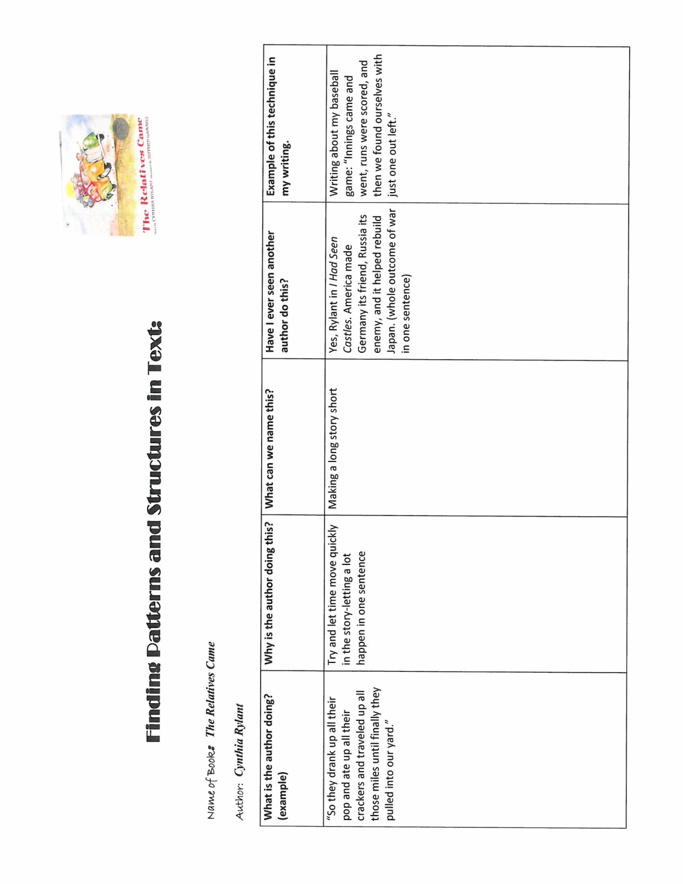

Slide 6
How do I Teach On Demand Writing to my primary students?
Model, Model, Model, using Interactive Writing.
Think aloud as you model.
Use organizers to help students focus on their thinking…modify or use those from upper grades to provide continuity.
Give students lots of opportunities to write and speak their opinions, arguments, and narratives..
Ask questions that lead students to forming opinions or arguments…ask “What is your Evidence?”
WRITE Every Day!!!!

Slide 7

Narrative Writing….1st Grade

Slide 8
What is new about On-Demand?
Assessed at Grades 5, 6, 8 , 10, and 11
Writing may be opinion/argument, informative/explanatory, or narrative.
There is less emphasis on format. The prompt may ask for article, essay, speech, letter, email, narrative…
Timing has changed
All students will have both a text-based prompt in addition to a direct prompt.

Slide 9
WWF
Whom am I writing to?
Who is the audience? How would you talk with this audience? What do they already know that you can leave out?
Why am I writing?
Are you writing to tell a story, to give your opinion, or to let your audience know what you know about a subject?
What format am I to use?
What is the form you are going to use to write to your audience?

Slide 10
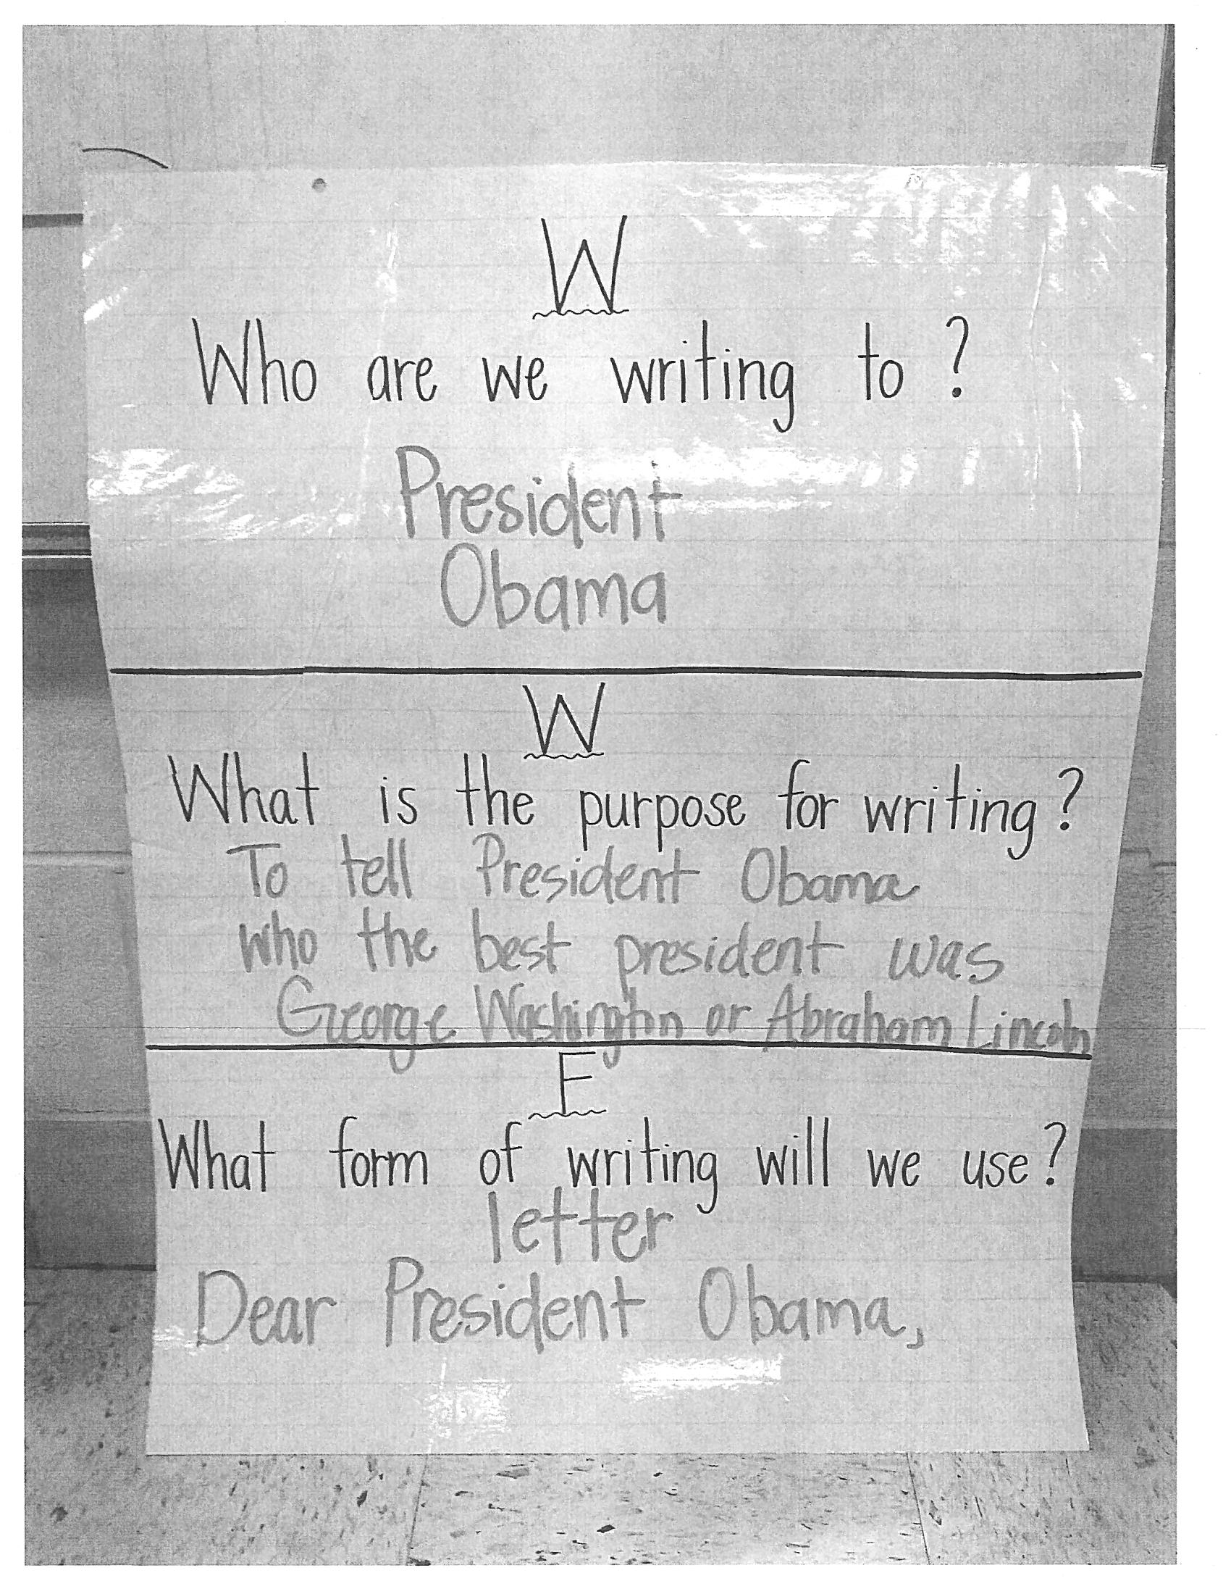
WWF

Slide 11
Situation and Directions
January 23, 2013
Dear Students of Mrs. Amanda’s Class,
I have heard that you are learning about George Washington and Abraham Lincoln. You will find that these were both very important people to our country. I would like to present a mission to each of you. After you research informational texts on George Washington and Abraham Lincoln, write a letter to me that gives your opinion on which president made the biggest difference in our country. Be sure and tell me why you think so.
Good luck on your mission. I look forward to hearing from you!
Sincerely,
President Barack Obama

Slide 12
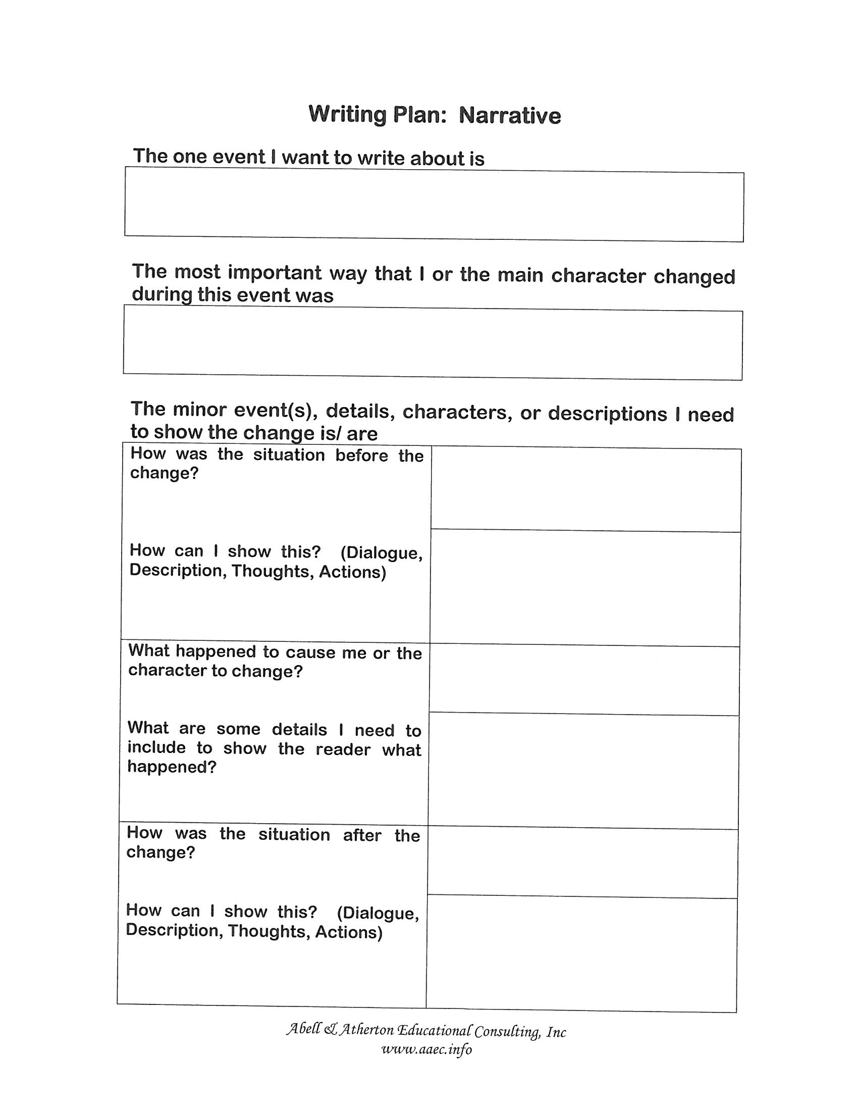
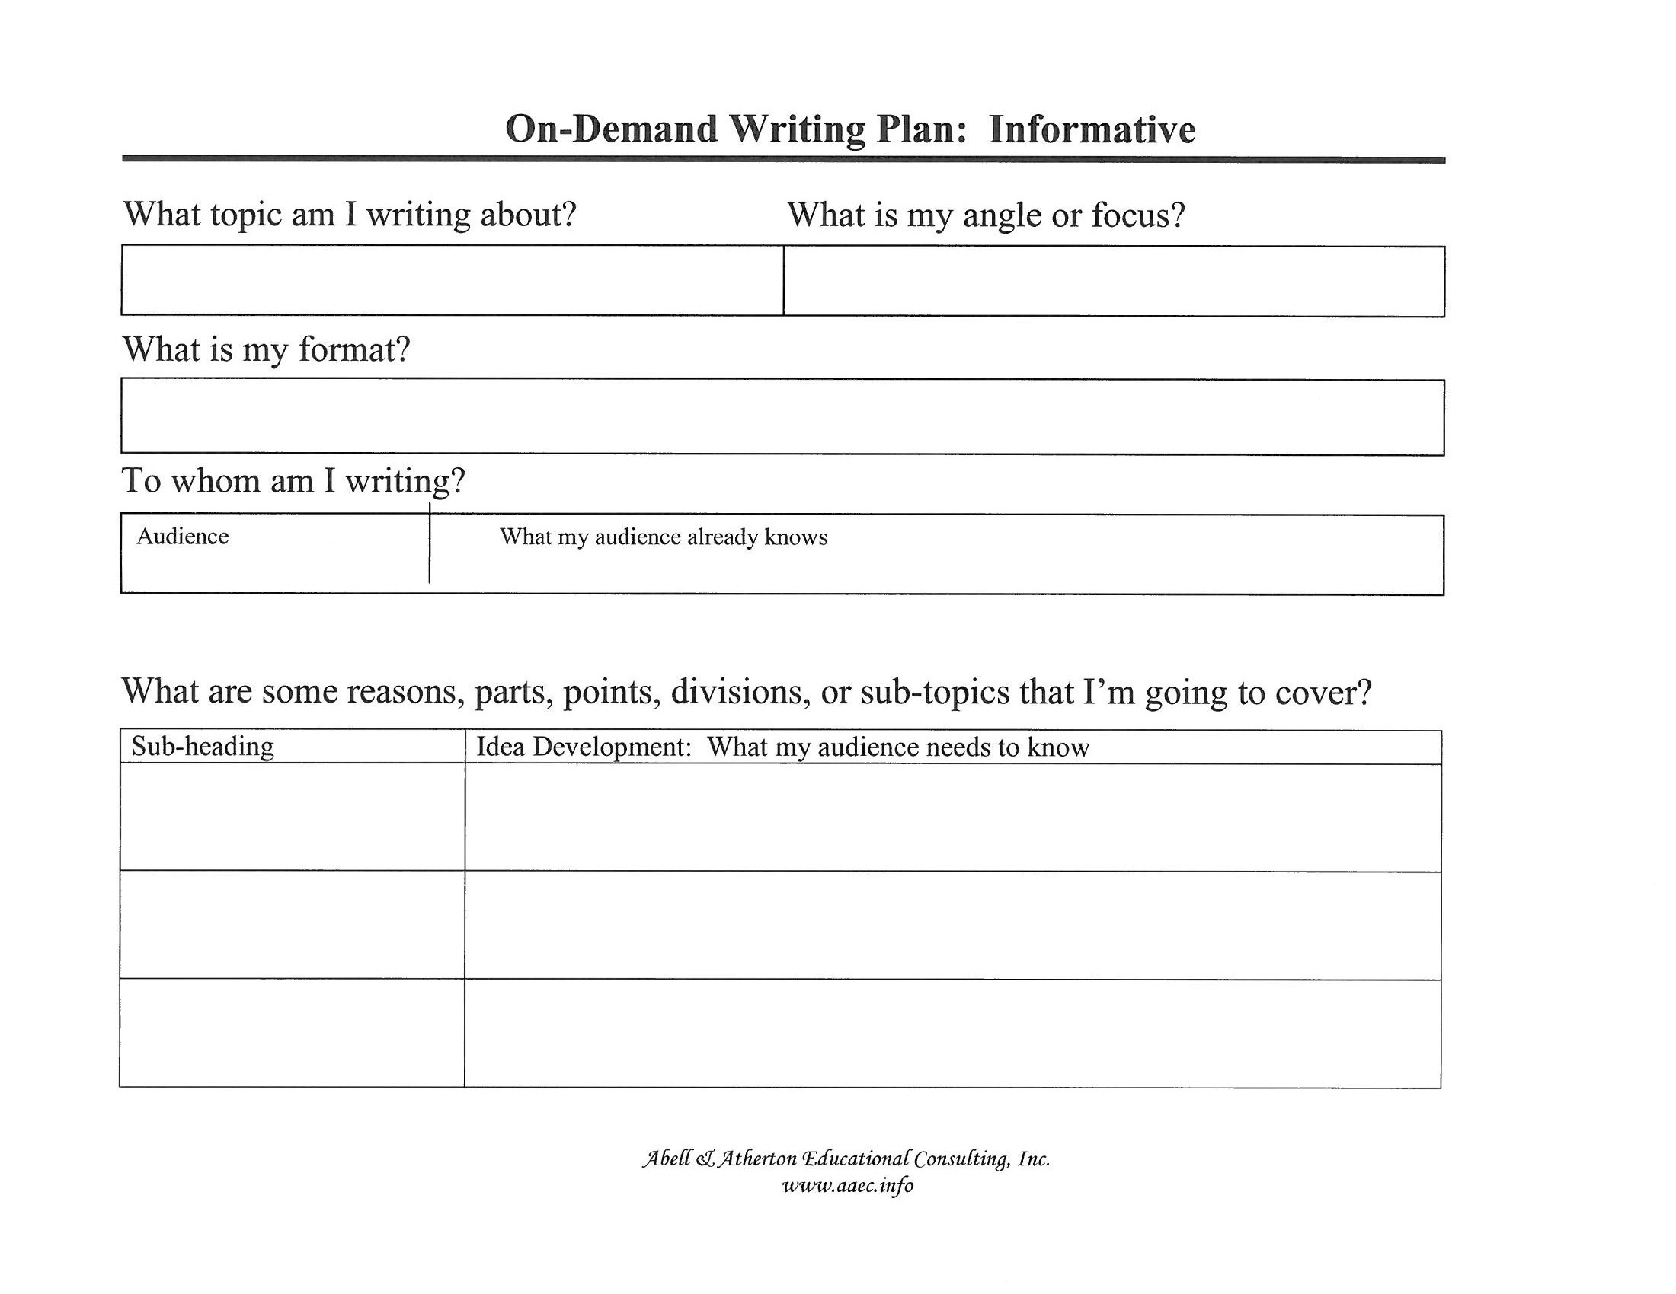
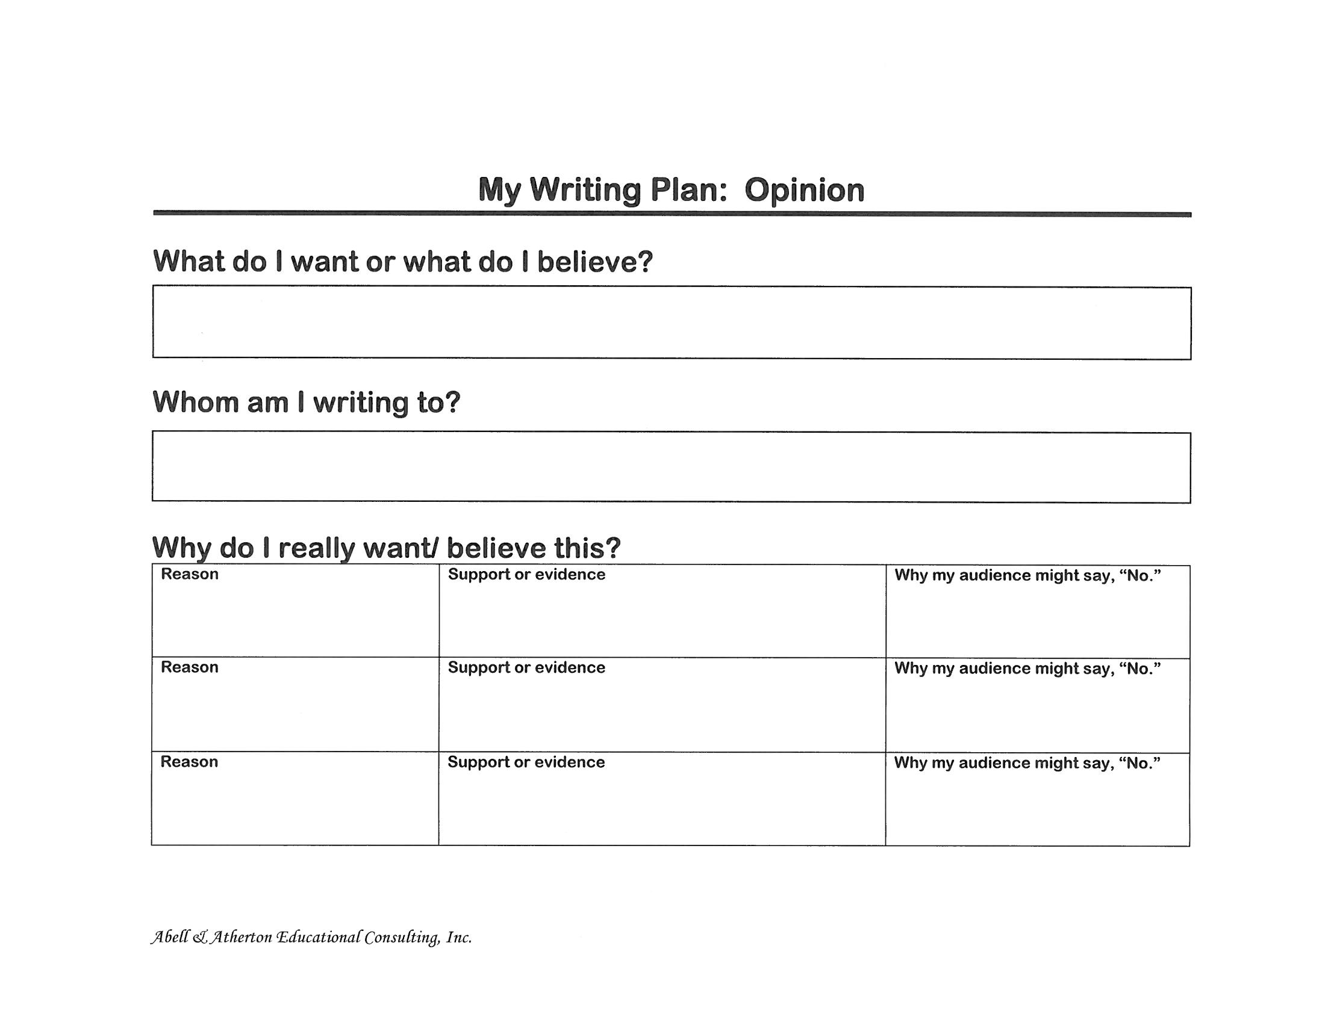
Model using the same organizers as those used in Grades 3 and up…
From Abell and Atherton Educational Consulting, Inc.

Slide 13
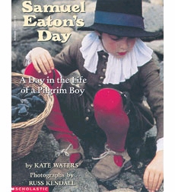
Opinion
Situation:
Long ago, in Samuel Eaton’s day, children had many difficult jobs to do.
Directions:
Write an essay telling your classmates which job you think would be most difficult. Use details to support your opinion.

Slide 14
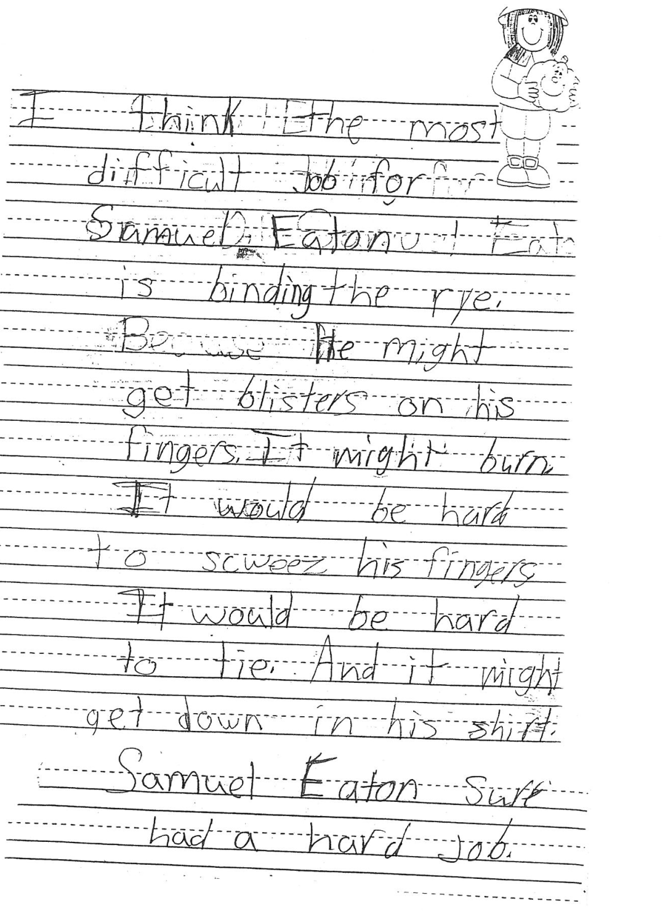
I think the most difficult job for Samuel Eaton is binding the rye. He might get blisters on his fingers. It might burn. It would hard to squeeze his fingers. It would be hard to tie. And it might get down in his shirt. Samuel Eaton sure had a hard job.

Slide 15
3.8 Paragraph
3.8 Paragraph= 3 points and 8 sentences
One clear idea, expressed in a topic sentence
3 reasons, points, or details which support
An example of each reason, point or detail
A conclusion which summarizes or ends the paragraph

Slide 16
What does the 3.8 look like in K-3?
K-1 Paragraph= 1 point and 4 sentences (1.4)
One clear idea, expressed in a topic sentence
1 reason, point, or detail which support
An example of each reason, point or detail
A conclusion which summarizes or ends the paragraph
2-3 Paragraph= 2 points and 6 sentences (2.6)
One clear idea, expressed in a topic sentence
2 reason, points, or details which support
An example of each reason, point or detail
A conclusion which summarizes or ends the paragraph

Slide 17
Assessment
Do your students know what good writing looks like?

Slide 18
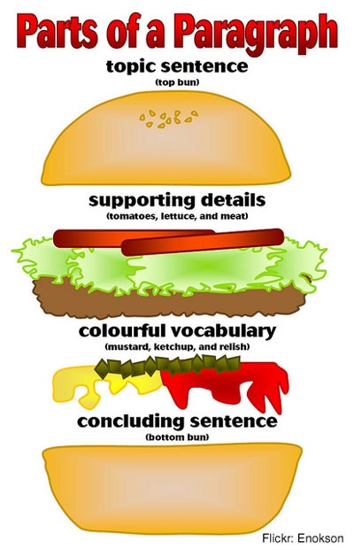
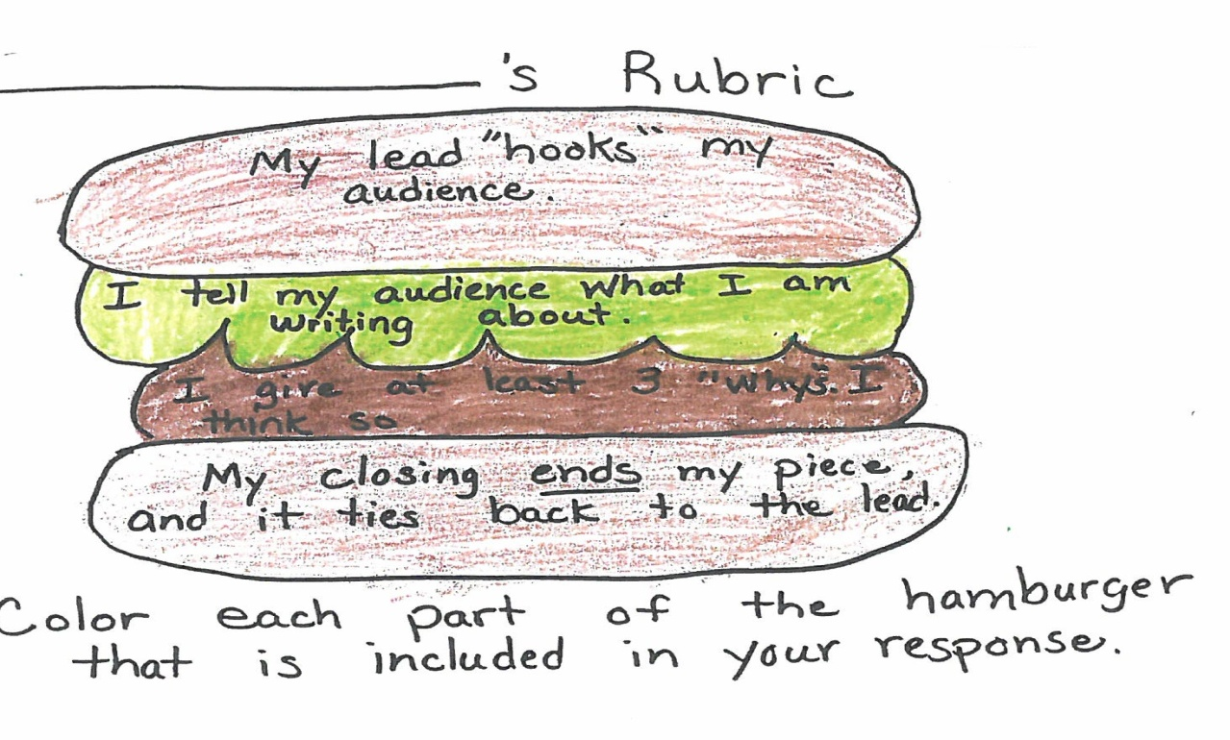
Hamburger Rubrics

Slide 19
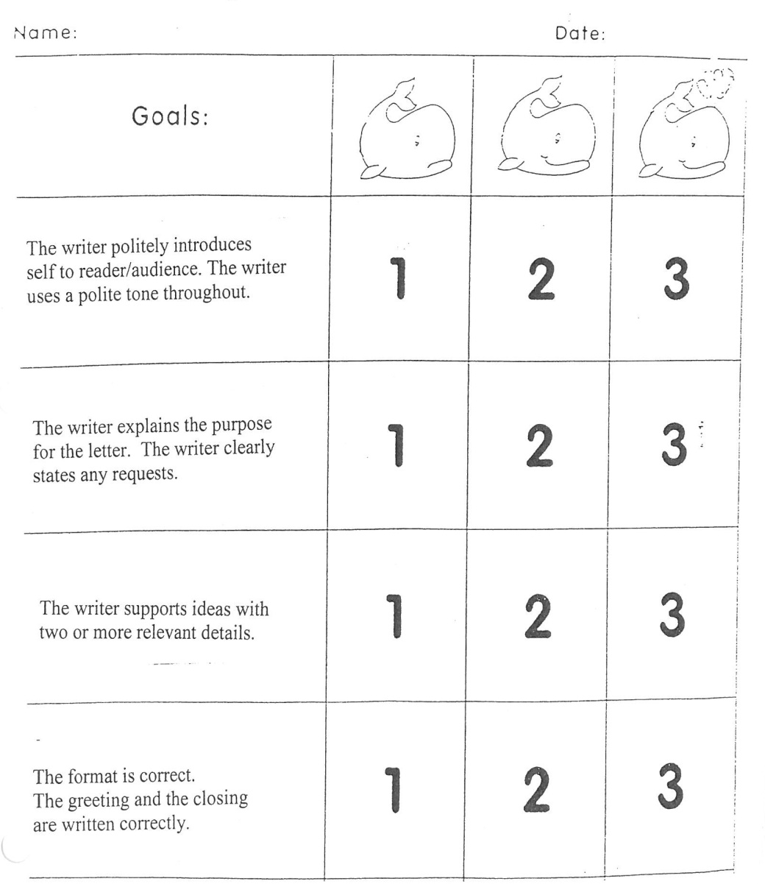
Primary Letter Writing Rubric

Slide 20

K-1 Paragraph Rubric
Reason or
Detail
Conclusion or Summary Sentence
A Clear Idea
Topic Sentence
Example of the
Reason or Detail

Slide 21
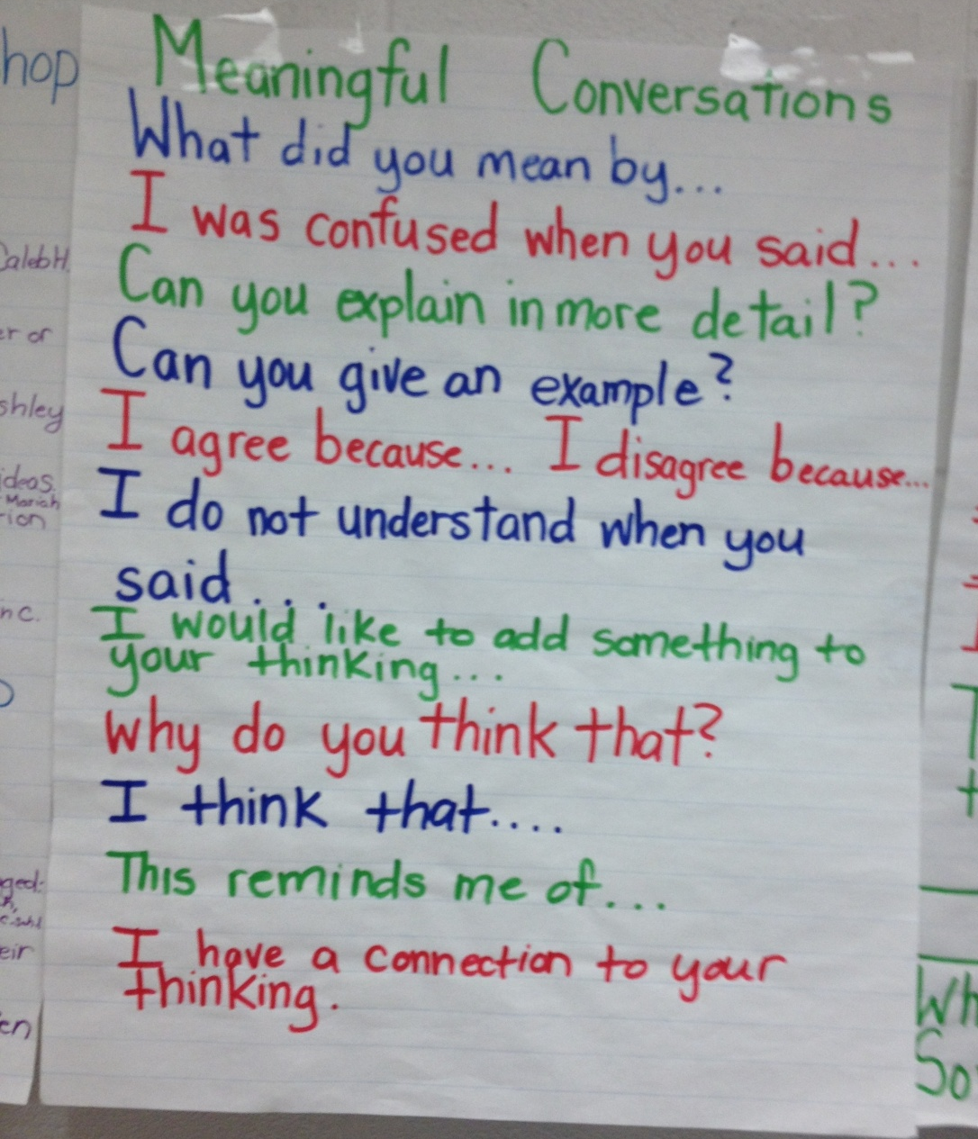
Explicitly Teach “Respectful Discourse”

Slide 22
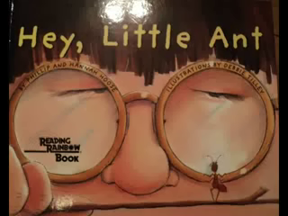
Hey, Little Ant
The little ant is trying to convince the boy to change his opinion of ants.
What evidence does he use?

Slide 23



Book Review Prompt (Opinion)
Situation:
We have read lots of books by Keven Henkes.
Directions:
What is your favorite Kevin Henke’s book? Write a book review for the classroom newspaper telling which book is your favorite. Give reasons why.

Slide 24
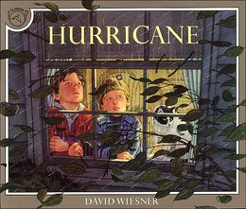
Narrative
Situation:
Today we read the book Hurricane by David Weisner. The story tells about the experiences two boys have when a hurricane hits and what they do after the storm.
Directions:
Write a letter to your friend telling about a time you were in a big storm. It may be fiction or non-fiction.

Slide 25
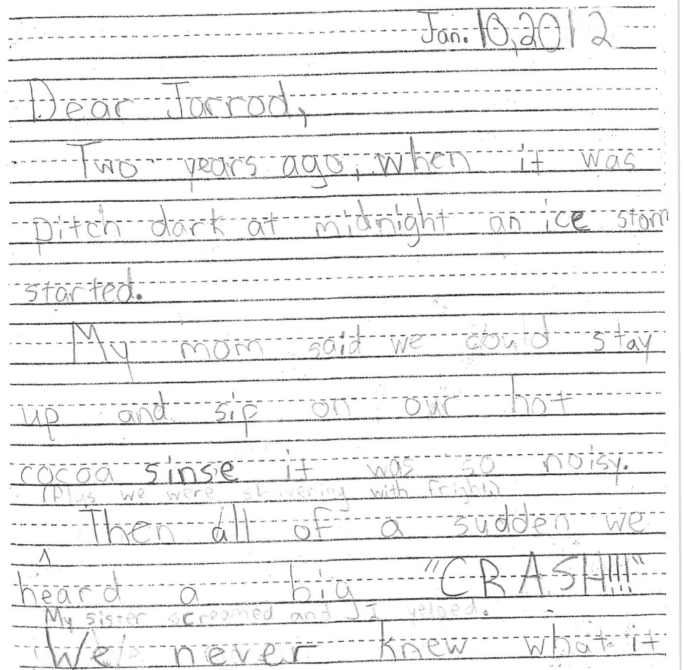
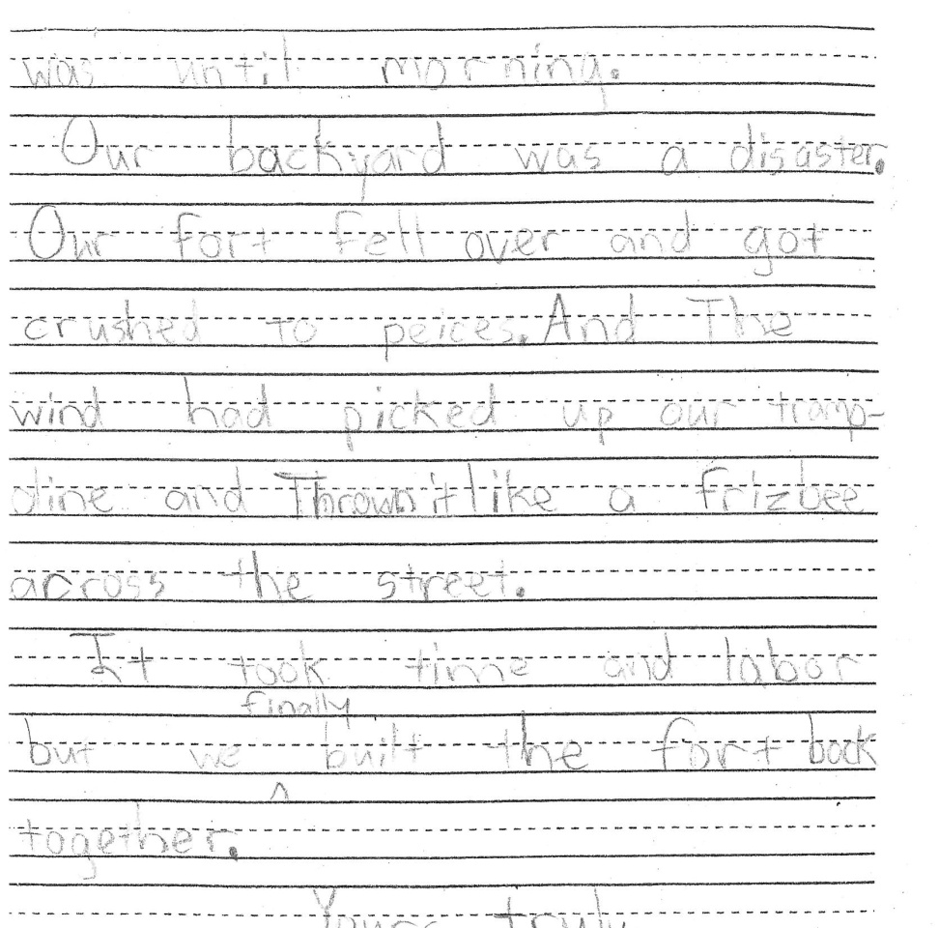
Narrative (Third Grade)
January 10, 2011
Dear Jarrod,
Two years ago, when it was pitch dark at midnight, an ice storm started.
My mom said we could stay up and sip on our hot cocoa since it was so noisy. (Plus we were shivering with fright.)
Then all of a sudden, we heard a big “CRASH!!!” My sister screamed and I yelped. We never knew what it until morning.
Our backyard was a disaster. Our fort fell over and got crushed to pieces. And the wind had picked up our trampoline and thrown it like a frizbee across the street.
It took time and labor, but we finally built the fort back together.
Yours truly,

Slide 26
Informative (2nd grade)
Informational Writing
Situation:
We have been studying how Arctic animals protect themselves from the cold. We did an experiment to see how whales stay warm in the icy waters.
Directions:
Write an article for our class book telling about your scientific findings.

Slide 27
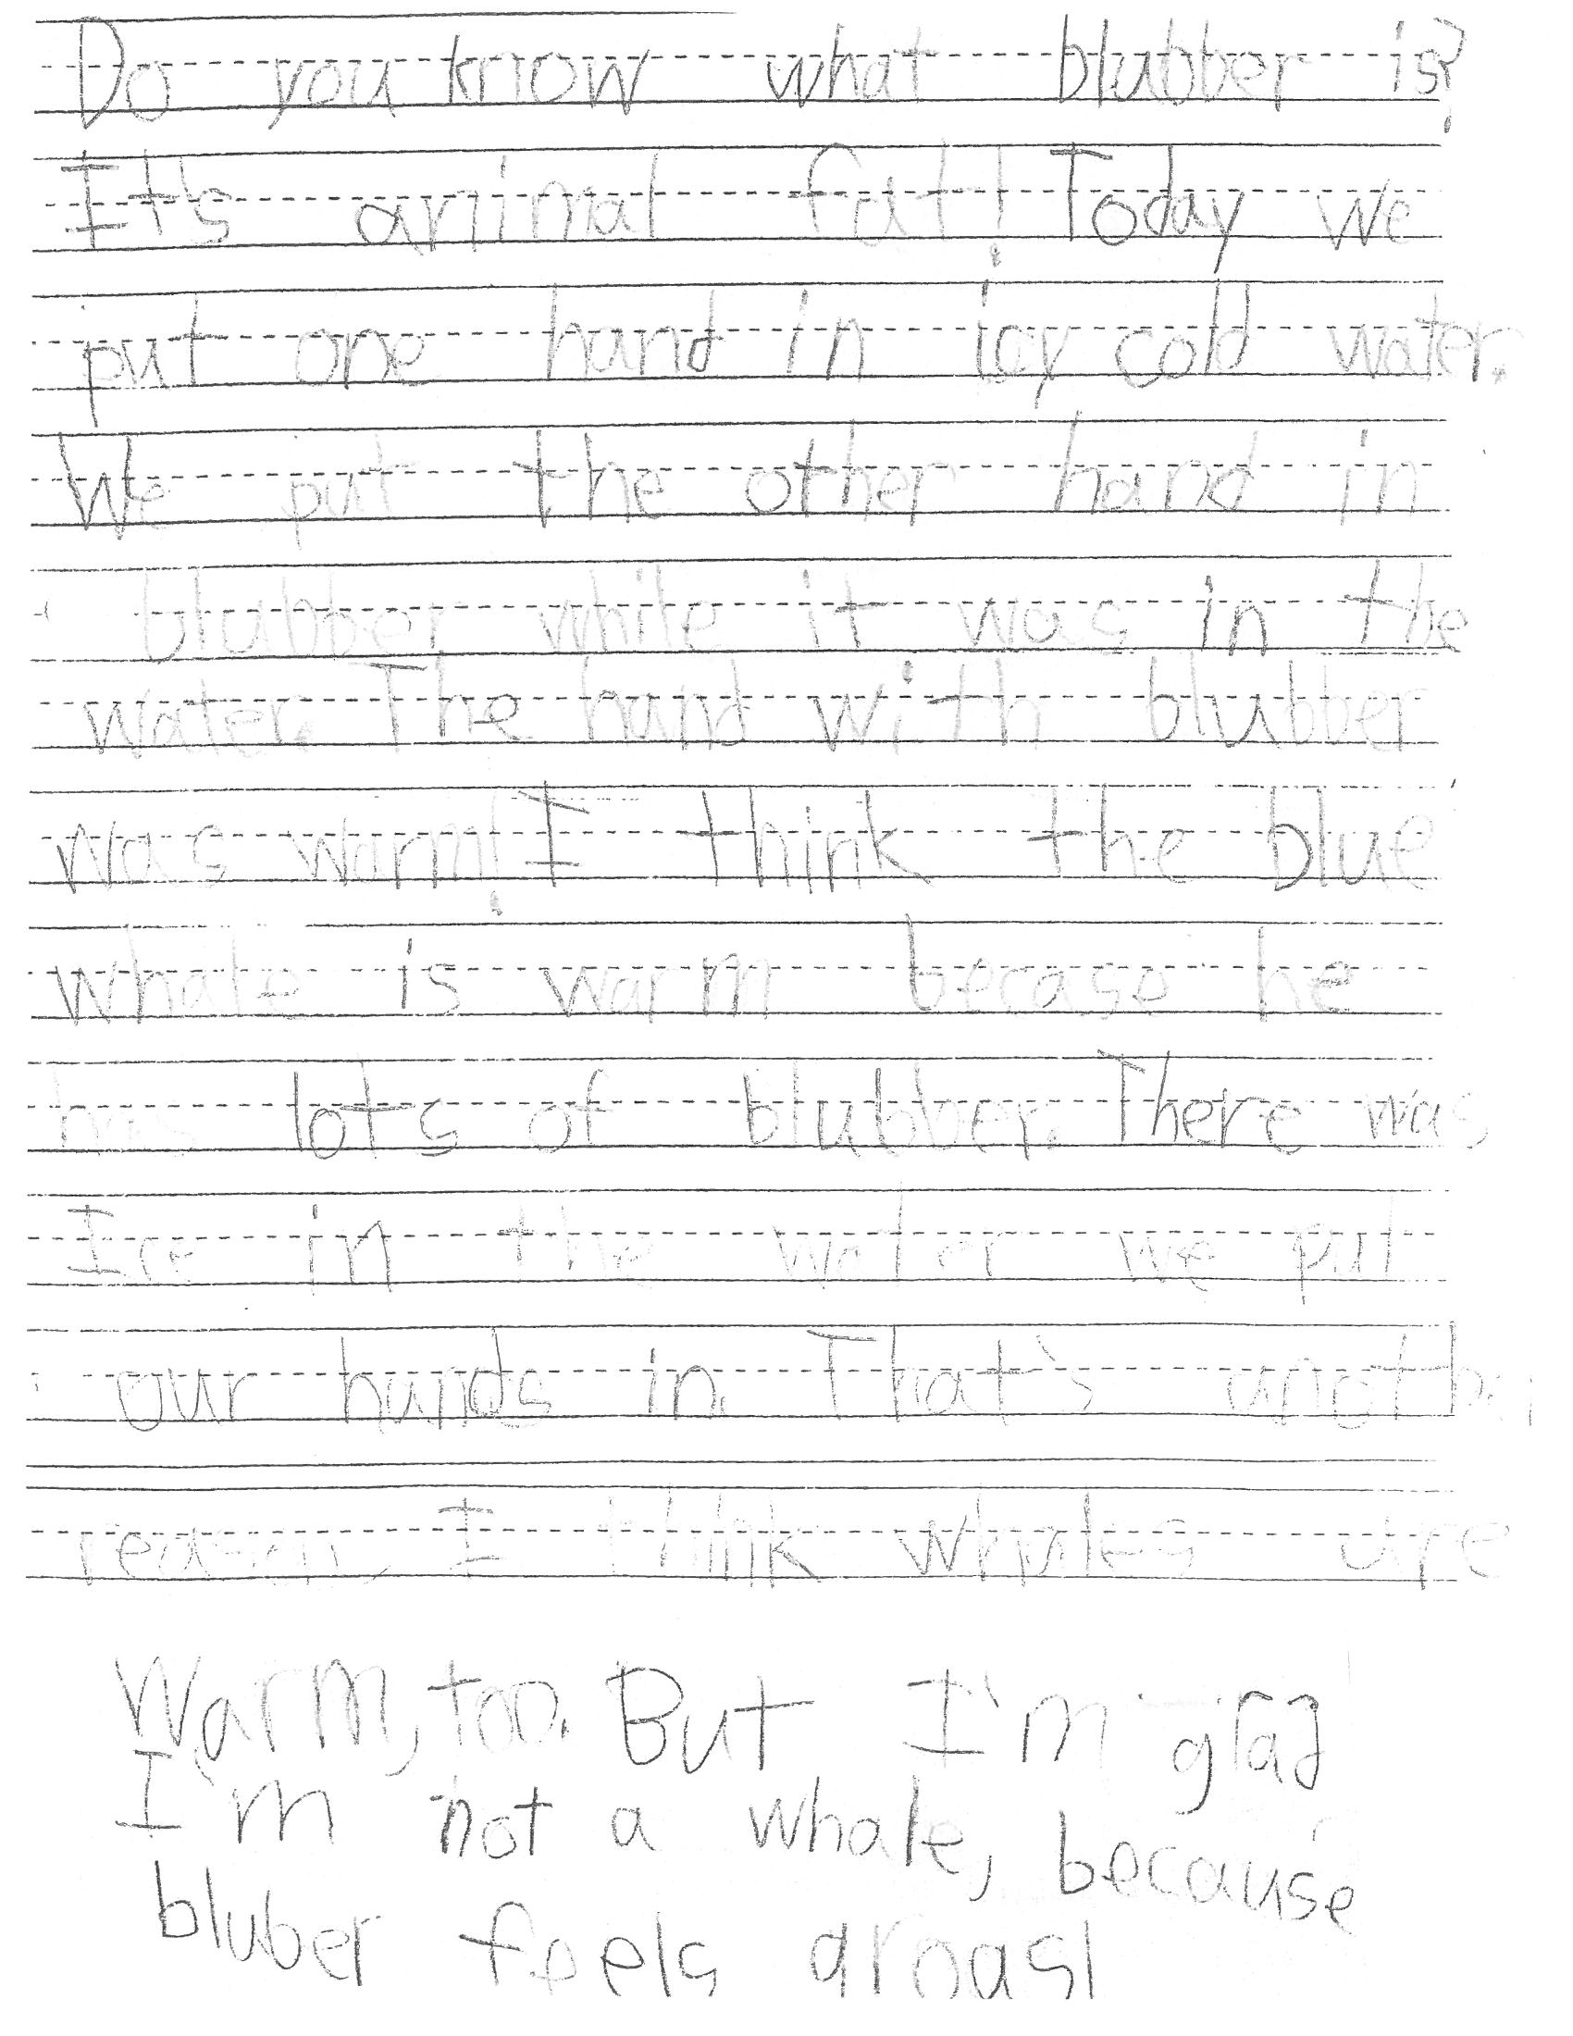
Second Grade On-Demand (Informative)
Do you know what blubber is? It’s animal fat! Today we put one hand in icy cold water. We put the other hand in blubber while it was in the water. The hand with blubber was warm! I think the blue whale is warm because he has lots of blubber. There was ice in the water we put our hands in. That’s another reason I think whales are warm, too. But I’m glad I’m not a whale, because blubber feels gross!

Slide 28
Inform/Explain (Kindergarten)
Situation:
We have been learning about ways to stay safe if there is a fire. Your neighbor did not learn about being safe in a fire.
Directions:
Make a chart with pictures and/or words to share with your neighbor showing him how to be safe if there is a fire in his house.

Slide 29
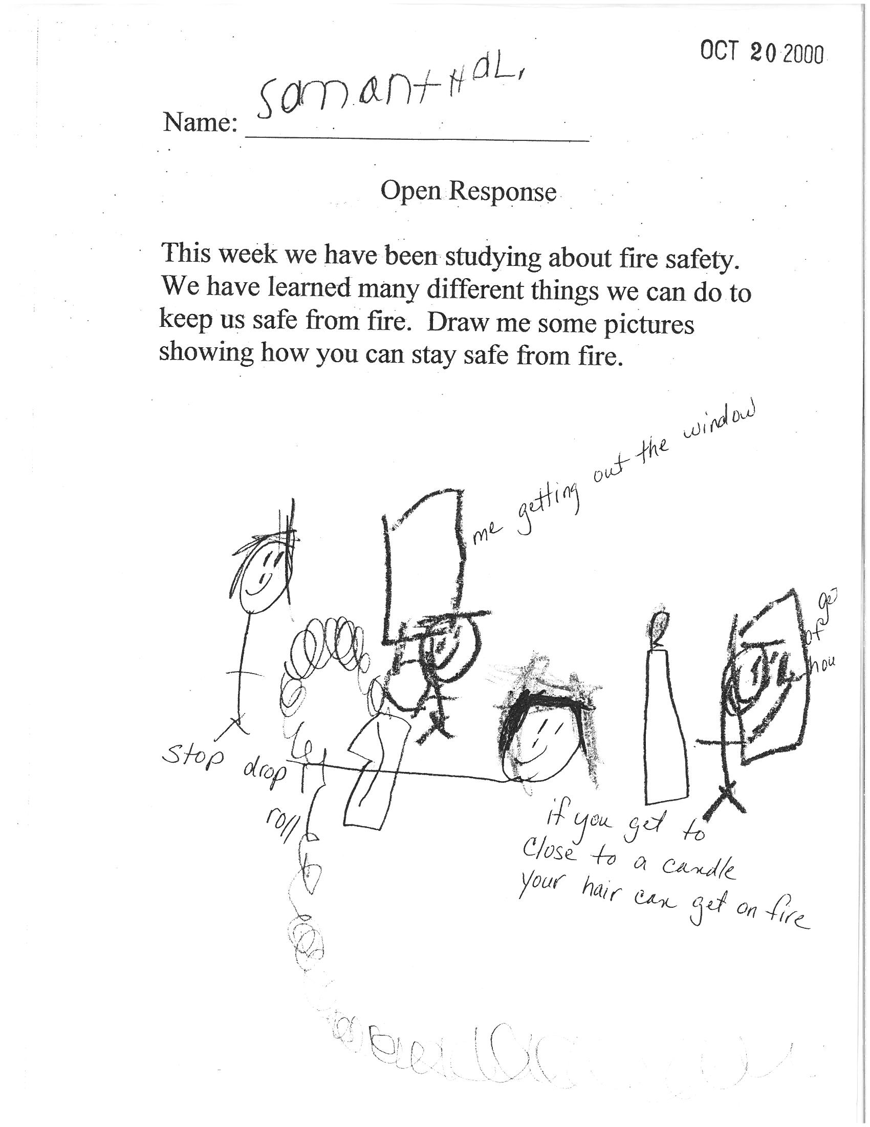
Kindergarten On-Demand (Inform)
Me getting out of my window.
Stop , drop and roll.
If you get too close to a candle,
you can get on fire.

Slide 30
What do I Already Have In Place?
Journals….Narrative Writing
Newspaper Center…Article to Inform or Give an Opinion
Writing Center…Narrative, Opinion, or Inform
Message Center…Letter Writing to Inform or Give Opinion
Science or Social Studies…Inform or Give Opinion

Slide 31
What Does It Mean to Read Like a Writer?
“I learned to write from writers. I didn’t know any personally, but I read…” Cynthia Rylant
“Always write and read with the ear, not the eye. You should hear every sentence you write as if it was being read aloud or spoken.
        C.S. Lewis
Notes:
Seamstress story from wondrous words

Slide 32
Reading Like a Writer …
“Read like a wolf eats, read when they tell you not to read, and read what they tell you not to read. If you read enough, ultimately when you sit down to write, that information is in your head and you can write, or it will start to work for you. The rest is learning mechanics, which you can learn from reading too.”
Gary Paulsen

Slide 33
Developing Readers and Writers
Foster a love of language
“Sell” books to your students
Create a Risk Free Environment
Build an Inviting Classroom Library
Read Aloud, Read Aloud, Read Aloud
Notes:
Talk over bullets…what do they mean…
Read Stella’s email…

Slide 34
Bibliography
Abell and Atherton Educational Consulting, Inc.
McLaughlin, Maureen and Mary Beth Allen (2002).
Guided Comprehension: A Teaching Model for
Grades 3-8. Newark, DE: International Reading Association.
National Institute for Literacy (2001). Put Reading First: The Research Building Blocks for Teaching Children to Read. Jessup, MD: the Partnership for Reading.
Hoyt, L. (2005). Spotlight on Comprehension. Portsmouth: Heinemann
Ray, Katie Wood (1999). Wondrous Words. Urbana, Illinois: National Council of Teachers of English.

